Slide 1
The preparation of students for mathematics in higher education
Dr. Marylu Dalton
February 22, 2020

Slide 2
College ready
Many students are unprepared for post-secondary education and/or for the 21st century workforce
(Ali & Jenkins, 2002; Conley, 2007; McCormick & Lucas, 2011)
This Photo by Unknown Author is licensed under CC BY

Slide 3
College-Ready defined
“the level of preparation a student needs in order to enroll and succeed, with remediation, in a credit-bearing general education course at a post-secondary institution that offers a baccalaureate degree or transfer to a baccalaureate program” (Conley, 2008)

Slide 4
Andragogy: “the art and science of helping adults learn” (Knowles, 1980, p.43)
ADULTS:
Learn what they need to know; need to know why they are learning something before they learn it. Importance of real life situations to introduce new topics (Rodrigues, 2012)
Are responsible for their own learning
Their experiences are very important in the process of adult learning
Adult learners must be ready to learn (to make a commitment to attend classes and complete all assignments)
Are motivated to learn what can be applied immediately to their life or work situations (Knowles, 2005)
Will respond to external motivation but internal motivation (self-esteem, self-motivation, improved quality of life) is much more powerful.

Slide 5
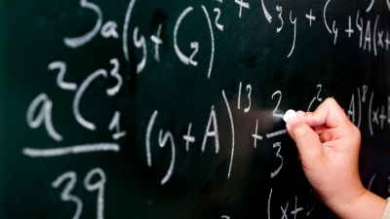
Mathematical readiness defined
“the degree to which a student is predicted to succeed in the college environment in mathematics”
(Corbishley & Truxaw, 2010, p. 72)
or
“a student’s ability to be successful in college-level mathematics courses without the need for remedial or developmental coursework”
(Conley, 2008; McCormick & Lucas, 2011).
This Photo by Unknown Author is licensed under CC BY

Slide 6
Mathematics Topics
solving equations in one or two variables | distributive property | rational exponents
computing without the use of a calculator | analyzing 2D and 3D figures | function notation
calculations with rational numbers | perimeter, area and volume | exponents
use of protractor, ruler and compass | combining algebraic expressions | similarity
understanding where formulas come from | multiplication facts | addition facts
quadratic equations and applications | manipulating inequalities | general algebra skills
finding inverses of invertible functions | algebraic manipulations | graphing functions
(Bettinger, Boatman, and Long 2013; Corbishley & Truxaw, 2016; McCormick & Lucas, 2011)

Slide 7
General skills
think mathematically at a complex level | find connections between ideas | generalization
visualize and manipulate data to solve problems | tending to precision and accuracy | analysis
think beyond memorization of formulas and procedures | solve problems in different contexts | conceptual understandings
extract relevant data from word problems | use reasoning to solve problems | make their own conjectures
determine the reasonableness of their solutions | proving concepts and conjectures | reflect on their reasoning
(Burdman, 2015; Conley, 2008; Corbishley & Truxaw, 2016; McCormick & Lucas 2011;
Olson, 2007; Rodrigues, 2012; Sonnert, Barnett, & Sadler, 2020)

Slide 8
Why are they unprepared?
Teachers in K-12 are focusing on high-stakes state exams (McCormick & Lucas, 2011)
Exams test what is easy to assess (lower-level thinking and math skills) (Boaler, 2016; Conley, D.T., 2007)
Students do not necessarily take a math class after Algebra 2 (McCormick & Lucas, 2011)
HS teachers focus on breadth rather than depth into fundamental math topics (McCormick & Lucas, 2011)

Slide 9
Factors that interfere with success
Students asked for factors that may interfere with their success in college mathematics
one-third (33%$)$of the responses named difficulty with mathematics content, course pacing and structure, or their own ability in mathematics (Acee, et al., 2017).
Math is often the least popular subject in school (Acee, et al., 2017; Boaler, 2016; Sonnert, Barnett, & Sadler, 2020).

Slide 10
Factors that interfere with success
Many people believe that “Math is hard” and that exerting effort does not help.
They believe that those who are born with an ability to do math are the ones who will be successful (Boaler, 2016; Dweck, 2008; Sonnert, Barnett, & Sadler, 2020).
They assume that math ability is fixed rather than adaptive, malleable and able to grow (Boaler, 2016)
Sonnert, Barnett, & Sadler (2020) cite several meta-analyses:
A correlation was found between negative attitudes and math anxiety with weaker mathematics performance. It was further noted that the weaker performance may also reinforce the negative attitudes and anxiety.

Slide 11
Cycle of Low Achievement (Ali & Jenkins, 2002)
Low expectations
Less challenging courses
Low level assignments/instruction
Poor test results

Slide 12
“All students would benefit from a more academically rigorous high school curriculum” (Ali & Jenkins, 2002)
Students:
should take four years of HS math should not be rushed through key courses and concepts in order to complete calculus in HS
need more time to complete key courses and concepts to be better grounded in mathematical understanding
should be prepared based on Content Standards (preparation as expected by faculty in higher education)
(Ali & Jenkins, 2002; Conley, 2007; Corbishley and Truxaw, 2016)

Slide 13
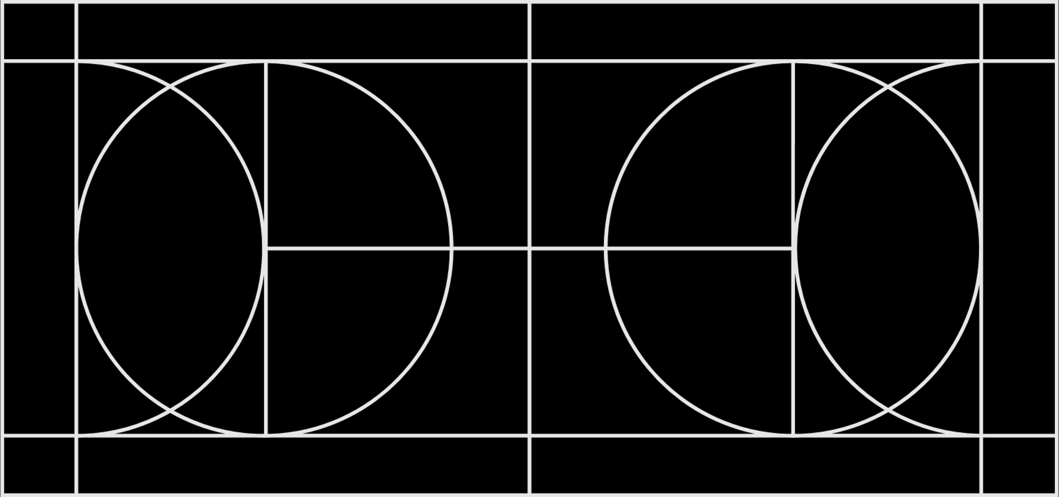
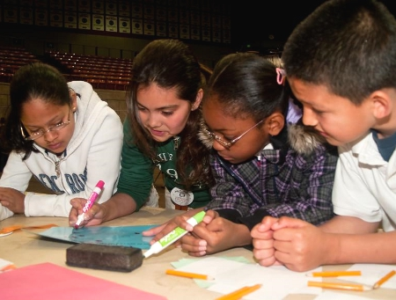
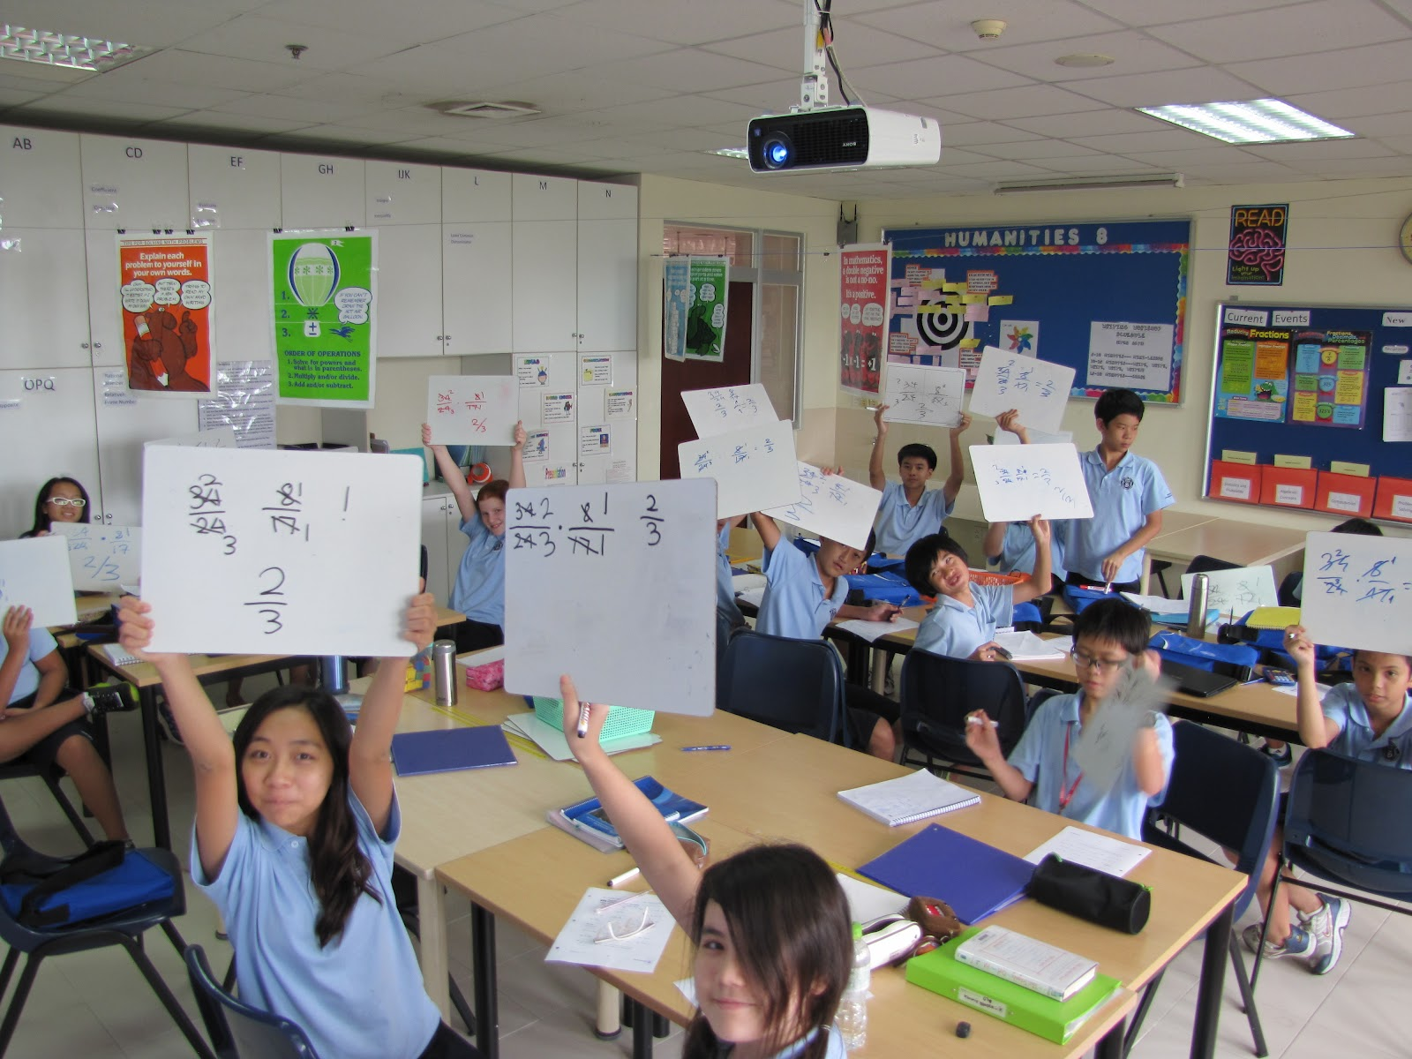
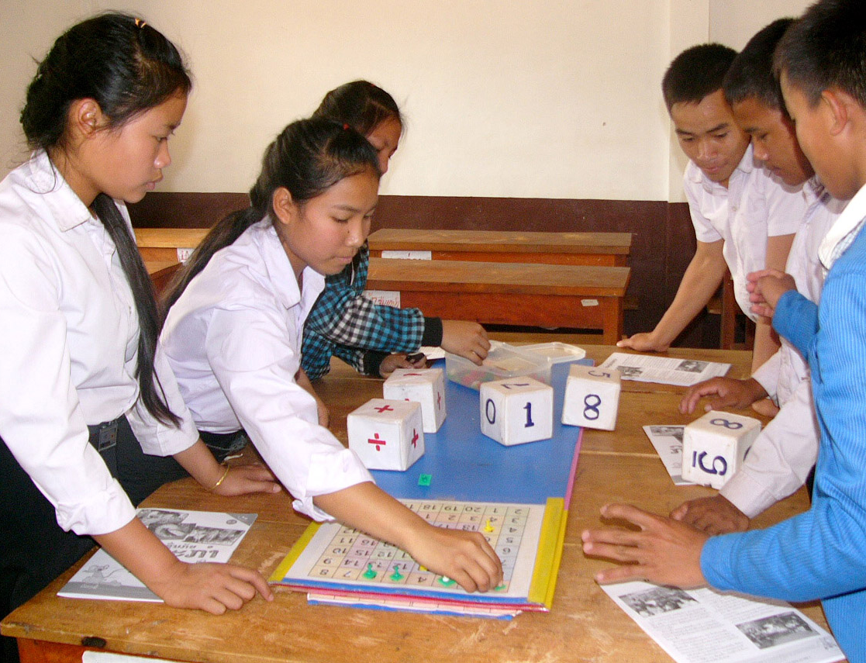
How can we better prepare students?
It’s not what we teach,
but how we teach it!
This Photo by Unknown Author is licensed under CC BY-NC
This Photo by Unknown Author is licensed under CC BY-NC
This Photo by Unknown Author is licensed under CC BY-SA

Slide 14
Principles of Andragogy
Instructor as facilitator, not lecturer
Directs student to a resource to solve a problem
Breaks down barriers and provides a “safe environment”
Uses scaffolding and collaboration
Encourages students to mentor each other
Encourages students to reflect on their experiences
Continuous feedback, positive reinforcement, alternative solutions
Overcoming math anxiety by building self-esteem
Connections to real-life
(Knowles M. , 1978; Knowles, Holton III, & Swanson, 2005; Rodrigues, 2012)

Slide 15
Principles of Andragogy
With these practices and strategies, we can hope to move all students from being learners who are dependent on their instructor to self-directed, independent learners with better critical thinking and problem-solving skills.

Slide 16
Common themes in the literature for the improvement of mathematics instruction
Students as active learners; Student talk rather than lecture; Teacher as facilitator | (Scrivener & Logue, 2016) (Rodrigues, 2012) (Knowles M. , 1978)(McCormick & Lucas, 2011) (Burdman, 2015) (Huebner & Corbett, 2008)(Hodara, 2013)
Work collaboratively | (Conley D. T., 2007) (Rodrigues, 2012) (Hodara, 2013)
Provide a safe environment for scaffolding, asking questions and talking about mistakes | (Rodrigues, 2012) (Huebner & Corbett, 2008)
Use real-life examples to orient learning (begin of class) | (Scrivener & Logue, 2016) (Rodrigues, 2012) (Knowles M. , 1978) (Knowles, Holton III, & Swanson, 2005) (Hodara, 2013)
Open questioning techniques | (Scrivener & Logue, 2016)
Students reflect on their learning; Critique their own work, rewrite and modify | (Rodrigues, 2012) (Hodara, 2013)(Conley D. T., 2007) (Huebner & Corbett, 2008)
Use the premise that “every student is a math student” | (McCormick & Lucas, 2011) (Huebner & Corbett, 2008)
A culture of high expectations and intellectual development for all students | (McCormick & Lucas, 2011) (Conley D. T., 2007) (Huebner & Corbett, 2008) (Ali & Jenkins, 2002)
Encourage stronger mathematical thinkers | (Corbishley & Truxaw, 2010) (Hodara, 2013) (Huebner & Corbett, 2008)
Conceptual understandings rather than rote use of algorithms and memorizing | (Madison, et al., 2015) (Conley D. T., 2007) (Hodara, 2013) (Huebner & Corbett, 2008)
Strategies for multiple learning styles | (McCormick & Lucas, 2011) (Huebner & Corbett, 2008)
Multiple representations of problems including equations, graphing, models, etc. | (Hodara, 2013) (Huebner & Corbett, 2008)

Slide 17
Standards of Mathematical Practice
1 Make sense of problems and persevere in solving them.
2 Reason abstractly and quantitatively.
3 Construct viable arguments and critique the reasoning of others.
4 Model with mathematics.
5 Use appropriate tools strategically.
6 Attend to precision.
7 Look for and make use of structure.
8 Look for and express regularity in repeated reasoning.
(CCSS, 2010)

Slide 18
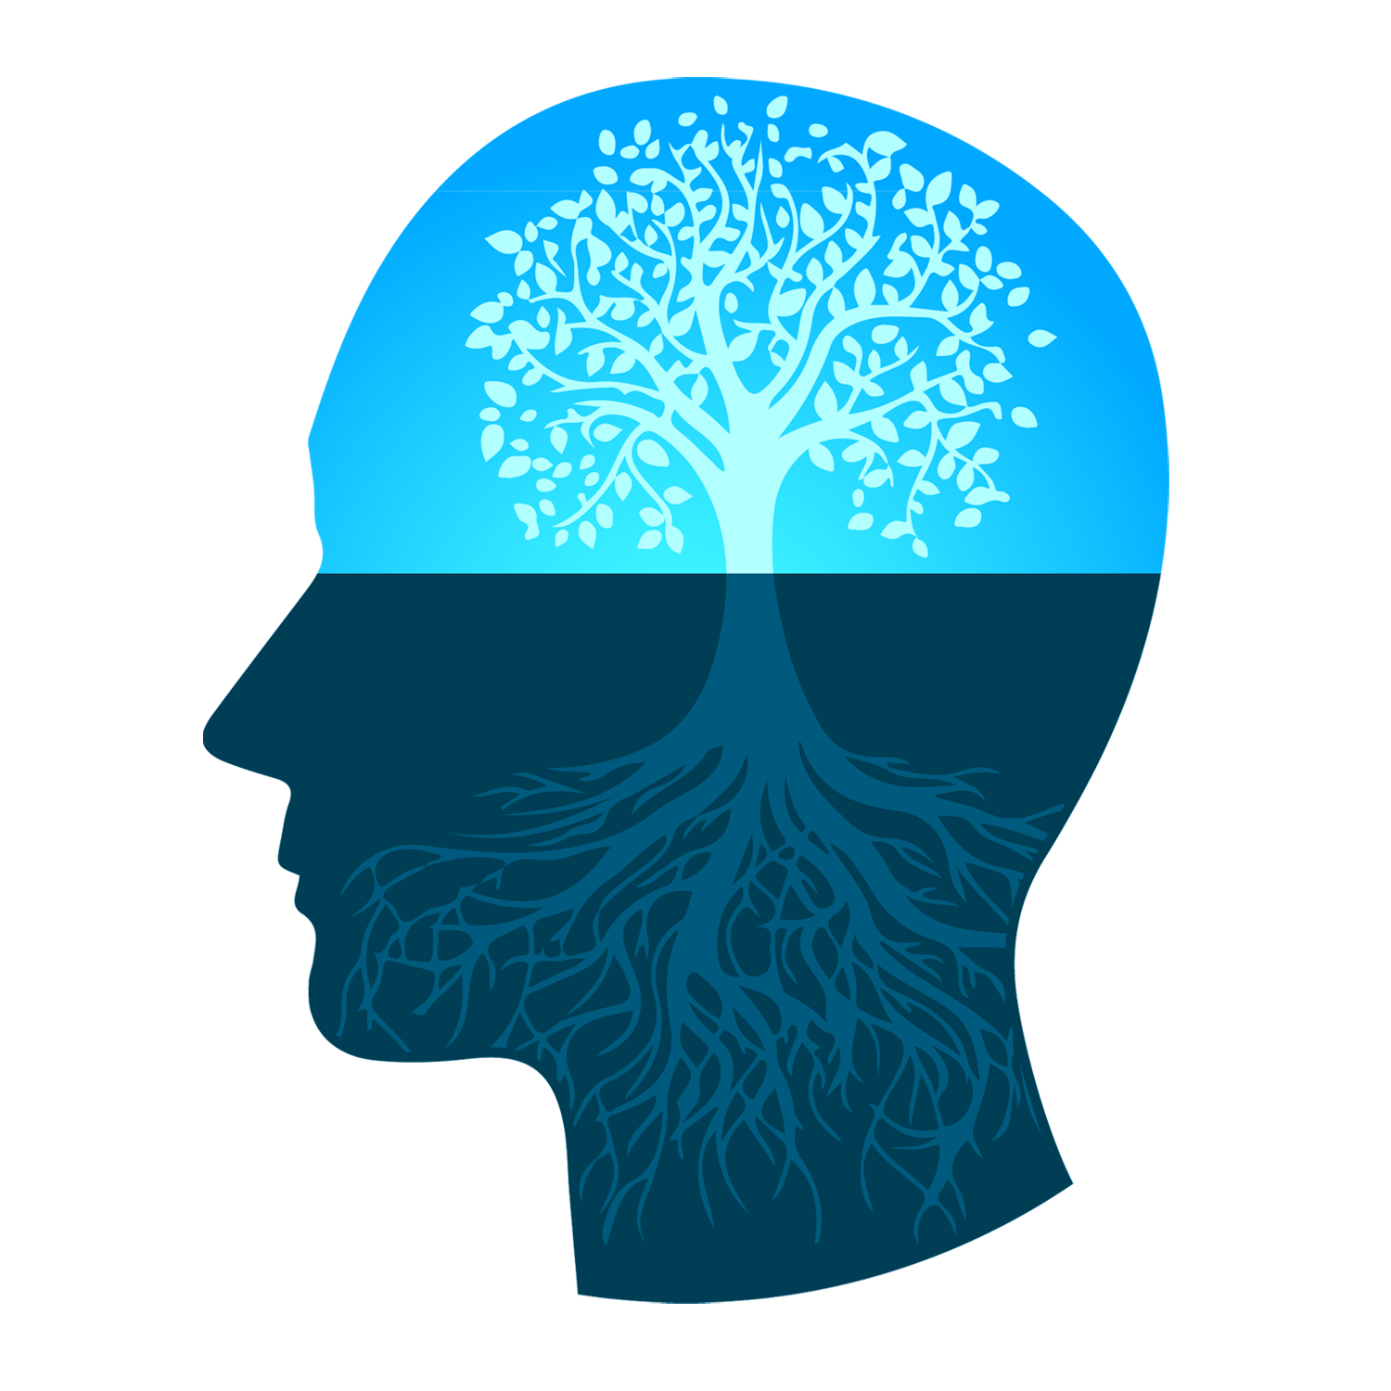
Growth Mindset
Carole Dweck (2015) and her colleagues have done considerable research into students’ mindsets, specifically how they perceive their abilities.
A student’s mindset about their ability in mathematics plays a key role in their motivation and achievement.
We can change a student’s mindset and boost their achievement (Dweck C. S., 2009; Dweck C. , 2015).
This Photo by Unknown Author is licensed under CC BY-NC

Slide 19
“The very best opportunities to learn come about when students believe in themselves” (Boaler, 2016, p. 5).
Growth mindset
where students believe that they can improve their intellectual abilities through effort and training.
Students may be a different skill levels, but everyone can improve their ability
(Dweck C. S., 2009).

Slide 20
Fixed Mindset v. Growth Mindset
Fixed
Growth
the belief that mathematical ability is innate, you are either born with ability to do mathematics or you are not (Boaler, 2016).
“I am not a math person” or “Math is hard”.
a fixed mindset has also been found to be damaging to high-achieving students.
Students who believe that they are smart are often less willing to try new strategies and more difficult work
fear that they may not continue to be successful (Boaler, 2016).
The fixed mindset is more prevalent in mathematics than in any other subject area (Dweck C. S., 2009).
Students with a growth mindset are significantly more oriented toward learning goals.
They believe in the power of effort – that effort improves ability no matter what the current level might be.
Students with a growth mindset care more about learning than their grades (Dweck C. S., 2009).

Slide 21
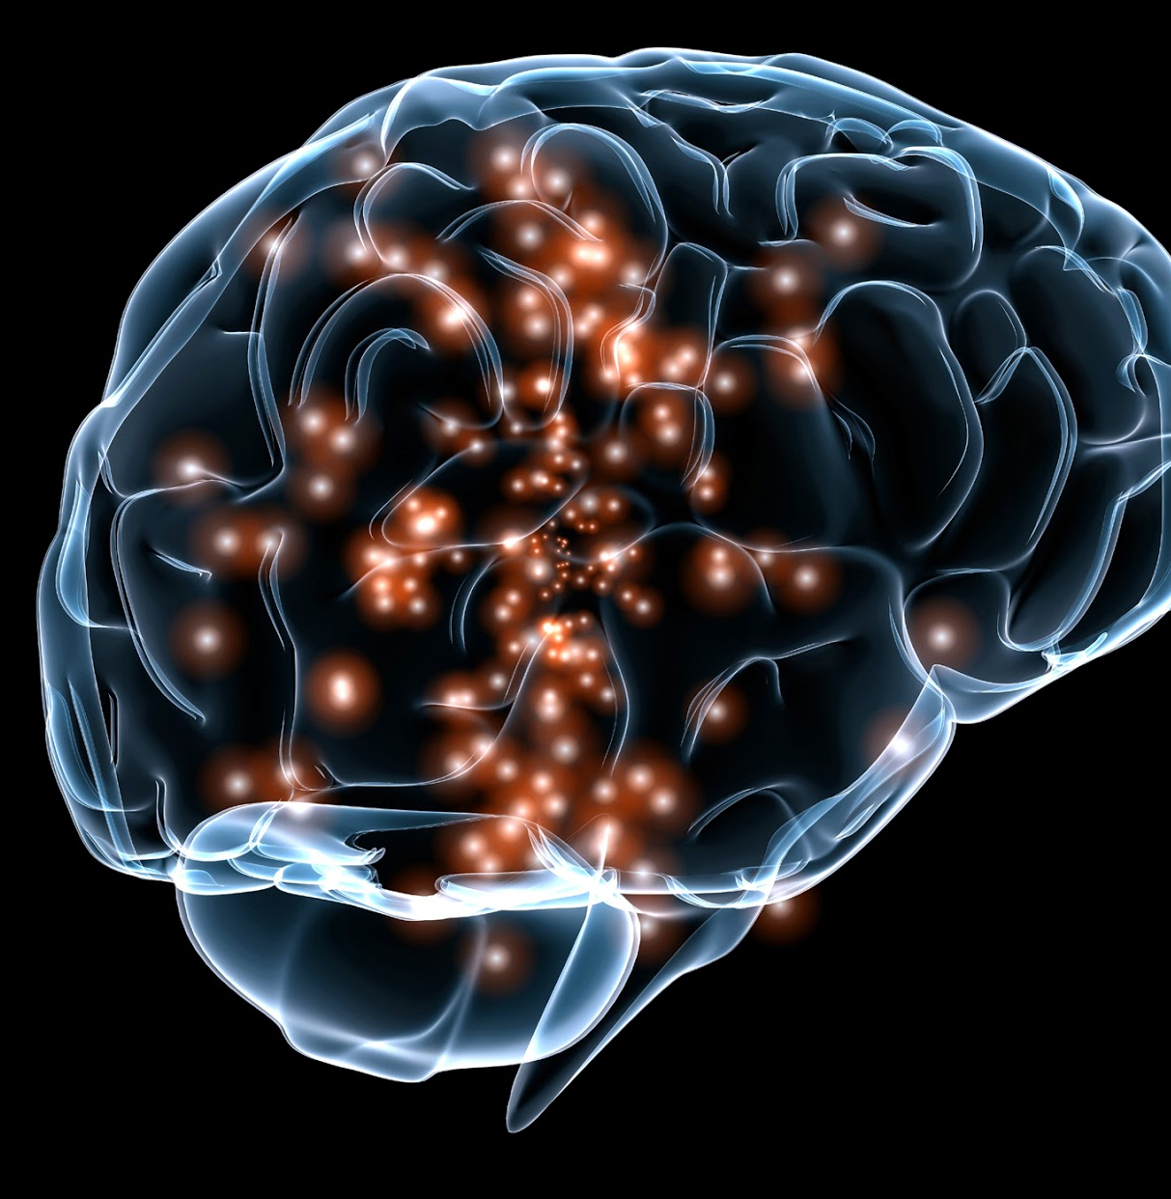
Introduce Growth Mindset early
Dweck and her colleagues created workshops for seventh graders to teach the growth mindset.
brain is a like a muscle that can grow stronger with use: when they learn something new the brain creates new connections.
Their brains grow when they make mistakes (Boaler, 2016).
Effort – students should be encouraged to try new strategies, seek input from others, and persevere when they are having difficulty (Dweck C. , 2015).
Praise students for their the effort and work they are doing, not for being smart.
This Photo by Unknown Author is licensed under CC BY-NC-ND

Slide 22
Boaler’s Mathematical Mindsets (2016)
Teachers encourage students to work as mathematicians
Believe in all students
Value struggle and mistakes
Give praise for growth
Encourage intuition and freedom of thought
Value depth over speed
Encourage students to pose questions, reason, justify, and be skeptical
Self-assess

Slide 23
Teachers should have opportunities for professional development in the growth mindset (Conley, D.T., 2007; McCormick & Lucas, 2011)
To present their curriculum in that framework
Give feedback to students in a way to encourage their efforts and allow for mistakes.
Be more aware of their students’ learning styles and needs as well as the mindset they begin with.
Be able to foster the growth mindset within each of her students.

Slide 24
Common themes in the literature = Components of the Growth Mindset Framework
Students as active learners; Student talk rather than lecture; Teacher as facilitator
Work collaboratively
Provide a safe environment for scaffolding, asking questions and talking about mistakes
Use real-life examples to orient learning (begin of class)
Open questioning techniques
Students reflect on their learning; Critique their own work, rewrite and modify
Use the premise that “every student is a math student”
A culture of high expectations and intellectual development for all students
Encourage stronger mathematical thinkers
Conceptual understandings rather than rote use of algorithms and memorizing
Strategies for multiple learning styles
Multiple representations of problems including equations, graphing, models, etc.

Slide 25
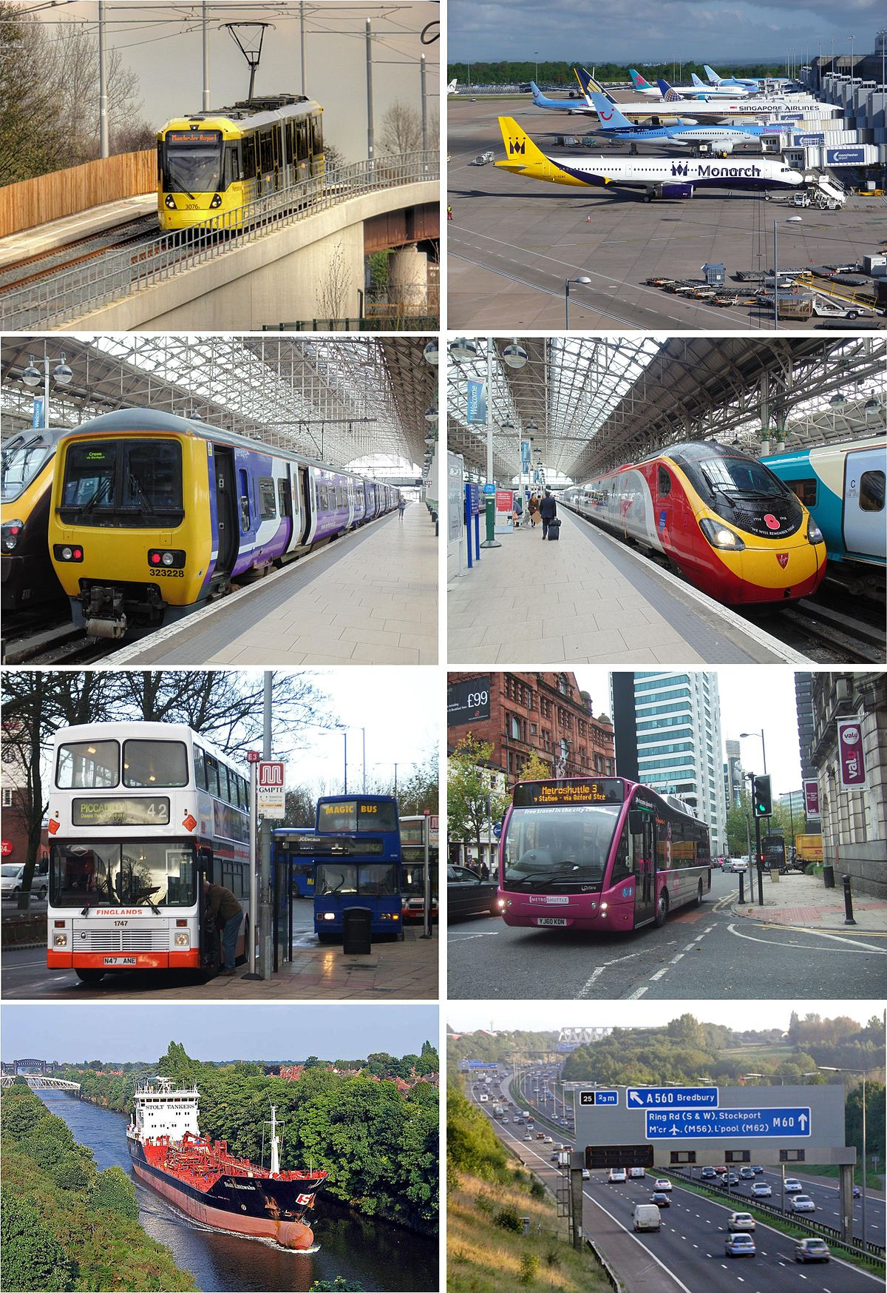
“The path to a growth mindset is a journey” (Dweck, C., 2015)
This Photo by Unknown Author is licensed under CC BY-SA

Slide 26
Current work on this topic
Piloting: I am currently teaching a Math Education content course for Elementary Education majors using Mathematical Mindsets as a framework
Students self-assess
Less skill-based homework, more reflection on the day’s work
No formal testing – instead student portfolios to show growth and conceptual understanding
Work as mathematicians
Benefits:
Less stress and math anxiety
More student talk and interaction
Students look for multiple approaches and representations without prompting
Students use their intuition
Safe environment for sharing all ideas

Slide 28
References
Acee, T. W., Barry, W. J., Flaggs, D., Holschuh, J. P., Daniels, S., & Schrauth, M. (2017). Student-perceived interferences to college and mathematics success. Journal of Developmental Education, 40(2), 2-9.
Ali, R., & Jenkins, G. (2002). The high school diploma: Making it more than an empty promise. The Education Trust - West, Oakland, CA.
Bettinger, E. P., Boatman, A., & Long, B. T. (2013). Student supoorts: Developmental education and other academic programs. The Future of Children, 23(1), 93-115.
Boaler, J. (2016). Mathematical mindsets: Unleashing students' potential through creative math, inspiring messages and innovative teaching. Jossey-Bass.
Burdman, P. (2015). Degrees of freedom: Diversifying math requirements for college readiness and graduation. Policy Analysis for California Education.
Conley. (2008). Rethinking college readiness. New Directions for Higher Education(144), 3-13. doi:10.1002/he.321
Conley, D. T. (2007). Redfining college readiness. Eugene, OR: Educational Policy Improvement Center.
Corbishley, J. B., & Truxaw, M. P. (2010). Mathematical readiness of entering college freshmen: An exploration of perceptions of mathematics faculty. School Science and Mathematics(110), 71-85.
Dweck, C. (2015, September 22). Carol Dweck revisits the "growth mindset'. Education Week.
Dweck, C. S. (2009). Mindsets and math/science achievement. Carnegie Corporation of New York & Institute for Advanced Study Commission on Mathematics and Science Education.

Slide 29
References (cont’d)
Hodara, M. (2013). Improving students' college math readiness: A review of the evidence on postsecondary interventions and reforms. New York, NY: Columbia University, Teachers College, Community College Research Center.
Huebner, T. A., & Corbett, G. C. (2008). Rethinking high school: Supporting all students to be college ready in math. San Francisco, CA: WestEd for the Bill and Melinda Gates Foundation.
Knowles, M. (1978). The adult learner: A neglected species (Second ed.). Houston, TX: Gulf Publishing Company.
Knowles, M. S., Holton III, E. F., & Swanson, R. A. (2005). The adult learner: The definitive classic in adult education and human resource development (Sixth ed.). Burlington, MA: Elsevier.
Madison, B. L., Linde, C. S., Decker, B. R., Rigsby, E. M., Dingman, S. W., & Stegman, C. E. (2015). A study of placement and grade prediction in first college mathematics courses. PRIMUS: Problems, Resources and Issues in Mathematics Undergraduate Studies, 25(2), 131-157.
McCormick, N. J., & Lucas, M. S. (2011). Exploring mathematics college readiness in the United States. Current Issues in Education, 14(1). doi:http://cie.asu.edu/ojs/index.php/cieatasu/article/view/680
National Governors Association Center for Best Practices, C. o. (2010). Common Core State Standards. Retrieved January 15, 2019, from Standards of mathematical practice.
Olson, L. (2007). What does 'ready' mean? Education Week, 26(40), pp. 7-12.
Rodrigues, K. (2012). It does matter how we teach math. Journal of Adult Education, 41(1).
Scrivener, S., & Logue, A. W. (2016). Building college readiness before matriculation: A preview of a CUNY Start evaluation. Building Knowledge to Improve Social Policy(April 2016), 1-12.
Sonnert, G., Barnett, M. D., & Sadler, P. M. (2020). The effects of mathematics preparation and mathematics attitudes on college calculus performance. Journal for Research in Mathematics Education, 51(1), 105-125.

