Slide 1

The Mean, the Myth, the Legend
Building Better Box Plots
Mr. Sam Ligo
Mr. Emmanuel Akoja
Instructor, Austin Peay State University
Department of Mathematics and Statistics
ligos@apsu.edu

Slide 2
The Concern
Box plots CAN quickly and efficiently convey information about data
Students struggle to interpret them
If the graphic is difficult to interpret then it’s not a good graphic

Slide 3
The Approach
Teach the foundations of the graphic
Break conventions
Make the graphic easier to understand and appreciate
It really is a powerful and elegant tool
Let’s make it accessible

Slide 4
The Concern (hidden)
The whole point of the box plot (aka the box and whisker plot) is to build a graphic that quickly and efficiently conveys to the viewer a lot of information about the data set such as its measures of center, its measures of spread, and its skewness.
However, a lot of people don’t know how to interpret them in order to understand the underlying data.
And, that defeats the purpose. If the graphic doesn’t efficiently convey the look and feel of the data, then it’s not a good graphic.

Slide 5
The Approach (hidden)
Let’s first understand how the graphic is made, and then we’ll understand how to read it and/or interpret it.
Let’s break conventions and make the graphic more easy to understand and appreciate
It really is a powerful and elegant tool for understanding data. Let’s make it accessible.

Slide 6
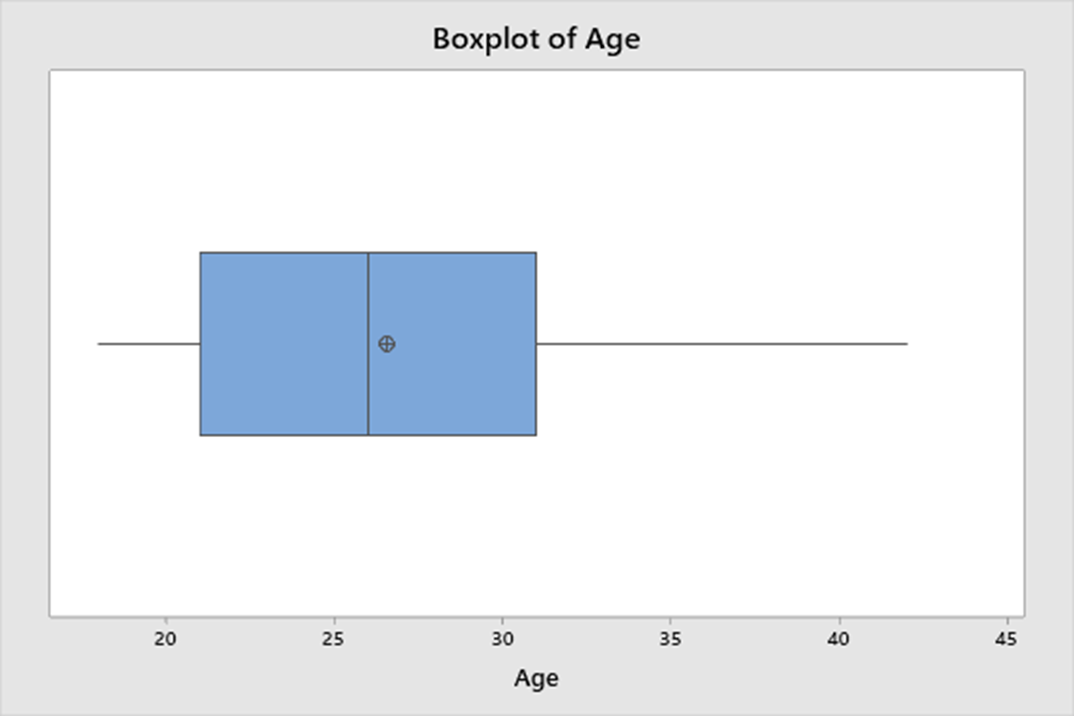
Box plot is good at ….
Mean | Standard Dev | Sample Size
Mode | Range | Outliers
Median | IQR Skewness | Quartiles

Slide 7
The Data, n = 400

Slide 8

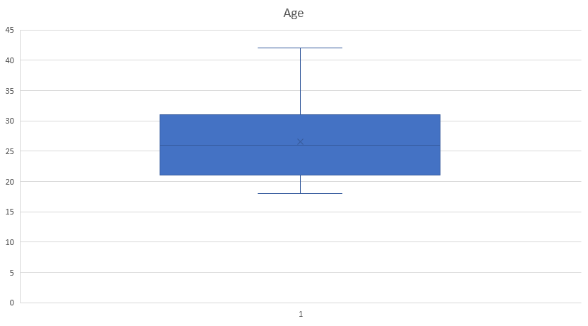
Excel Box Plot

Slide 9
Descriptive Statistics (draw the number line)

Slide 10
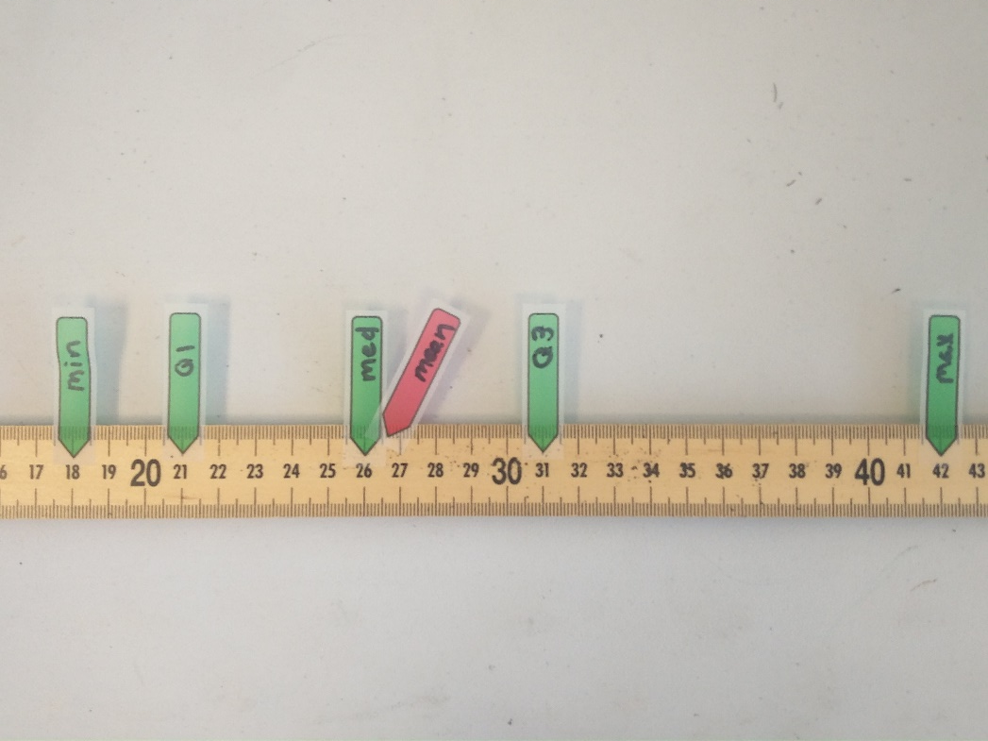

Slide 11
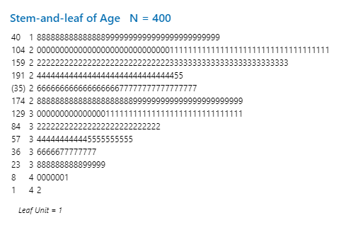
Stem and Leaf Plot

Slide 12
Stem and Leaf Plot
n/2 = 200
The median is between person #200 and #201

Slide 13
Stem and Leaf Plot
n/2 = 200
n/4 = 100
Q1 ends after person #100

Slide 14
Stem and Leaf Plot
n/2 = 200
n/4 = 100
Q3 ends after person #300

Slide 15
Bootleg Histogram of Age (draw in bell curve)
x axis

Slide 16
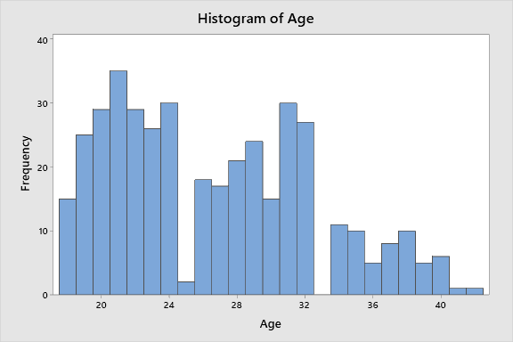
Histogram of Age (draw in bell curve)
x axis

Slide 17
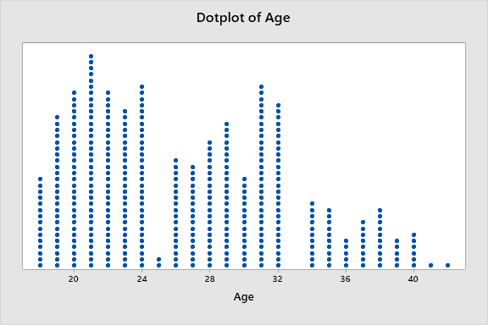
Dot plot of Age
x axis

Slide 18
With quartiles identified
x axis

Slide 19
Each box contains ¼ of the data points, n = 400, each box has 100
2nd Quartile
1st Quartile
4th Quartile
3rd Quartile
x axis

Slide 20
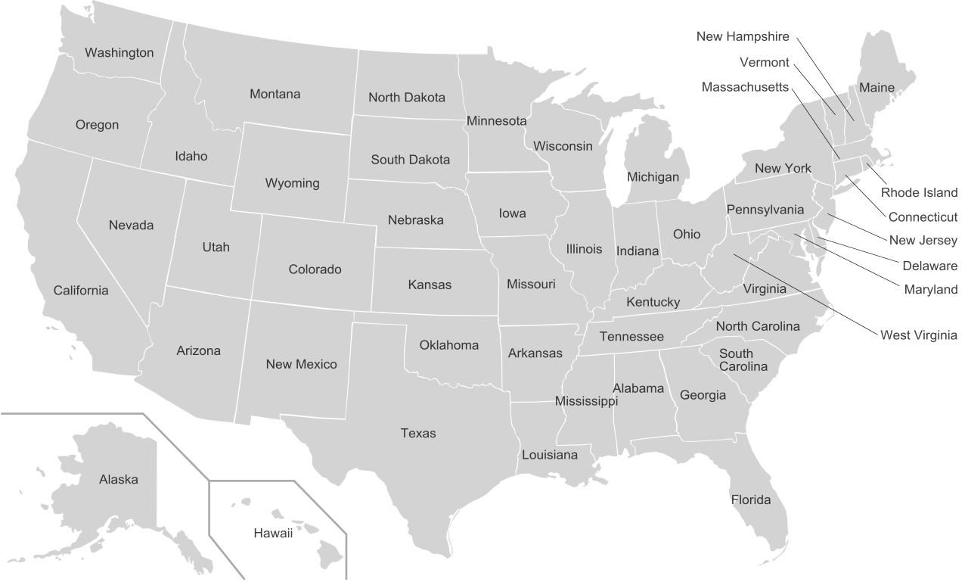

Slide 21
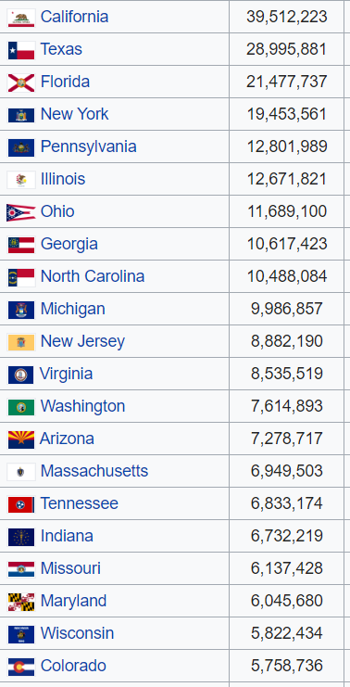
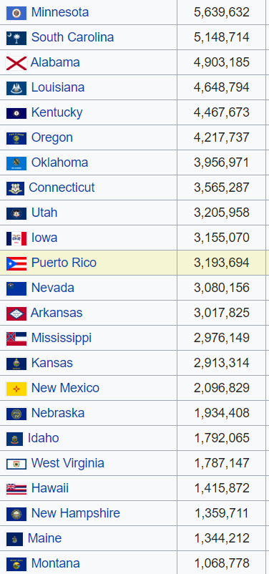
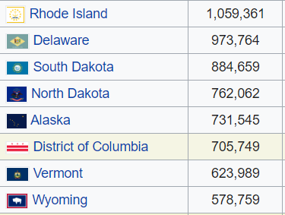

Slide 22


Slide 23

Montana data point

Slide 24
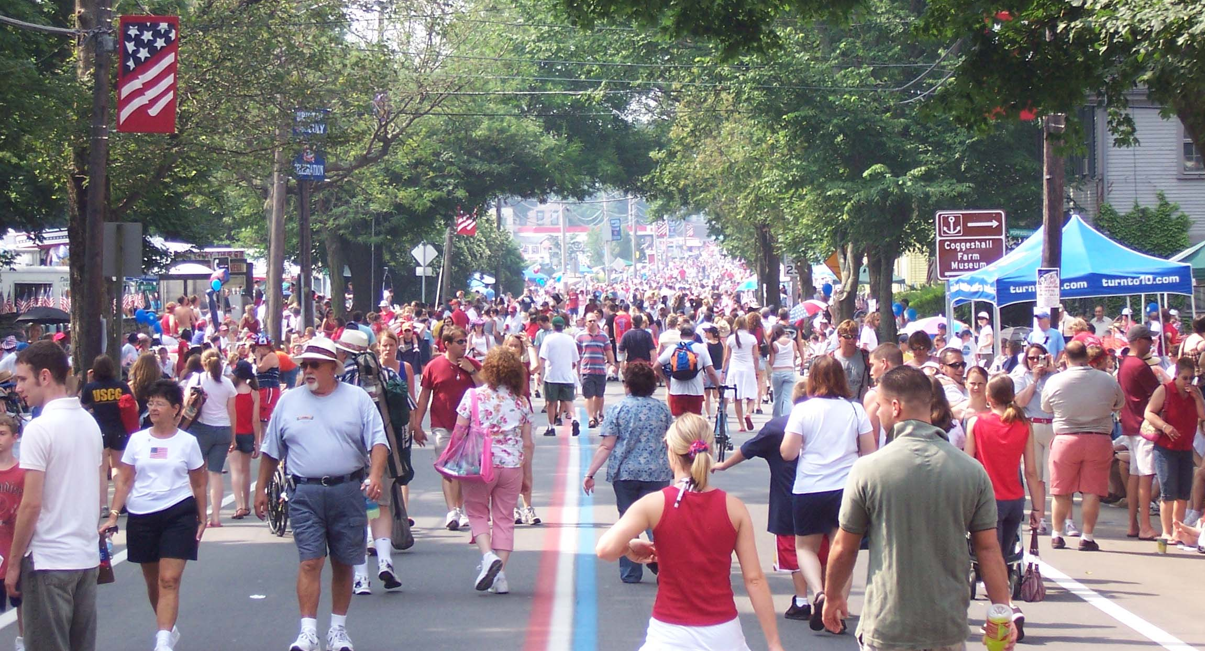

Rhode Island data points

Slide 25
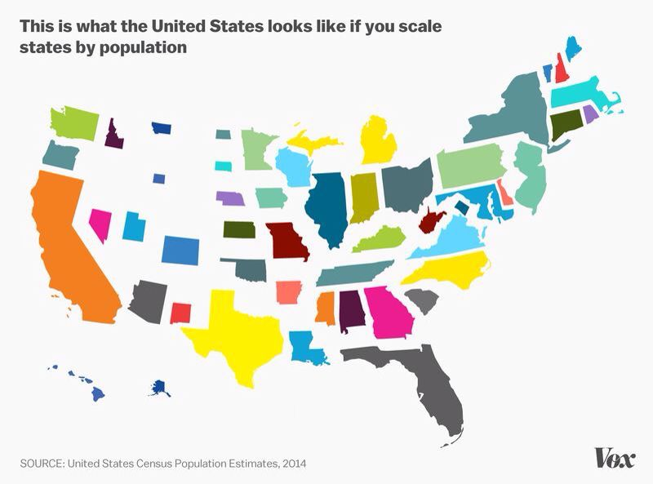

Slide 26
Each box contains ¼ of the data points, n = 400, each box has 100
2nd Quartile
1st Quartile
4th Quartile
3rd Quartile
Montana
Rhode Island
x axis

Slide 27
Draw in bell curve
2nd Quartile
1st Quartile
4th Quartile
3rd Quartile
Montana
Rhode Island
x axis

Slide 28

Color Coded Box Plot
1st Quartile
2nd Quartile
3rd Quartile
4th Quartile
x axis

Slide 29
Minitab Box (and Whisker) Plot
Where might we find an age distribution like this?
x axis

Slide 30
Minitab Box (and Whisker) Plot
med
Q1
Q2
Q3
range
mean 26.547
21
26
31
IQR
x axis

Slide 31
Skewness
Follow the tail. The data are skewed in the direction of low density.
“Heavy” is the opposite of “skewed” eg data that are heavy on the left are skewed to the right and vice versa
Quick test for skewness (not failsafe):
  mean > median is skewed right
  mean < median is skewed left
  mean = median is symmetrical

Slide 32
Excel Box Plot
x axis

Slide 33
Minitab Box Plot
x axis

Slide 34
Breaking Conventions
Turn horizontal
Add mean symbol
Abandon the TI84 box plot

Slide 35
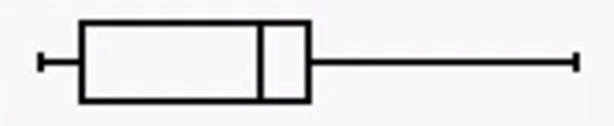
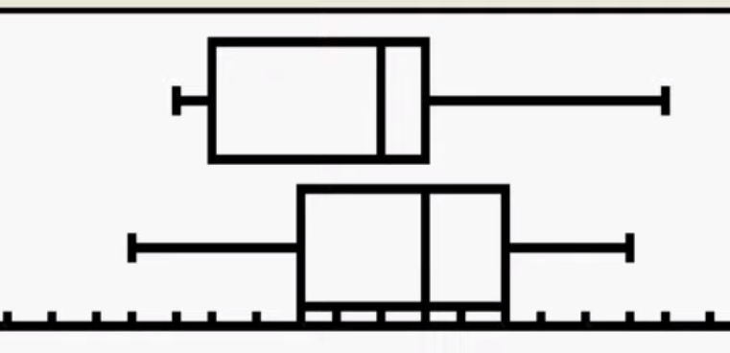
Box plots on the TI-84

Slide 36
Downside to TI 84 Box Plots
Takes a long time to teach it
Low success rate, low retention rate
Can only be done on small data sets which is relatively pointless. The point of a box plot is to help us understand the behavior of a large data set that we cannot otherwise visualize
Never going to be done in real life with any real dataset
Time better spent with output from 1-Var Stats

Slide 37
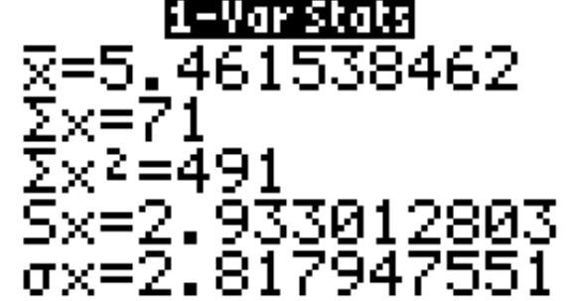
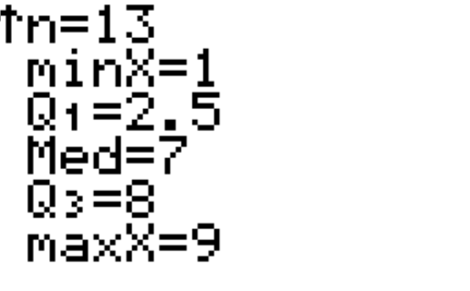
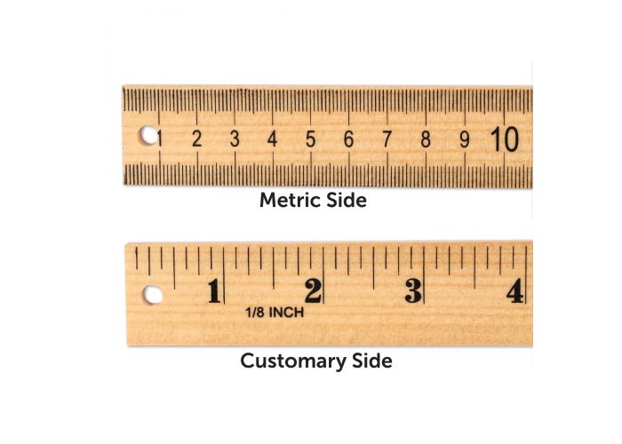
Summary Data from TI 84
(focus on this instead of TI84 boxplots)
Easy to put this graphic on an exam and have students transfer their 1-VarStats from calculator to graphic
med Q2
min
Q1
mean
Q3
max

Slide 38
Graph A
1st
quartile
2nd
quartile
3rd
quartile
4th
quartile

Slide 39
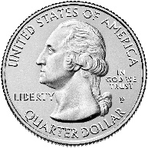
Graph A
1st
quartile
2nd
quartile
3rd
quartile
4th
quartile

Slide 40
Graph B
1st
quartile
2nd
quartile
3rd
quartile
4th
quartile

Slide 41
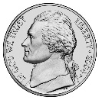
Graph B
Q1
Q2
Q3
Q4

Slide 42
Graph C
1st
quartile
2nd
quartile
3rd
quartile
4th
quartile

Slide 43

Graph C
Q1
Q3

Slide 44
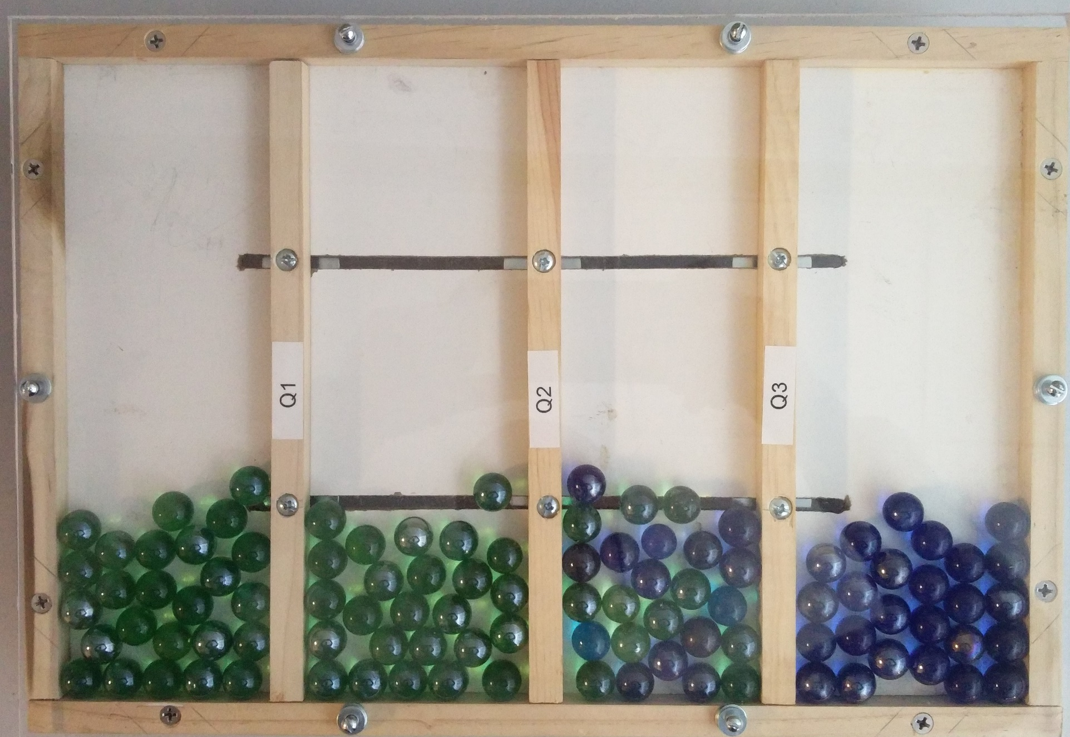
Uniform

Slide 45
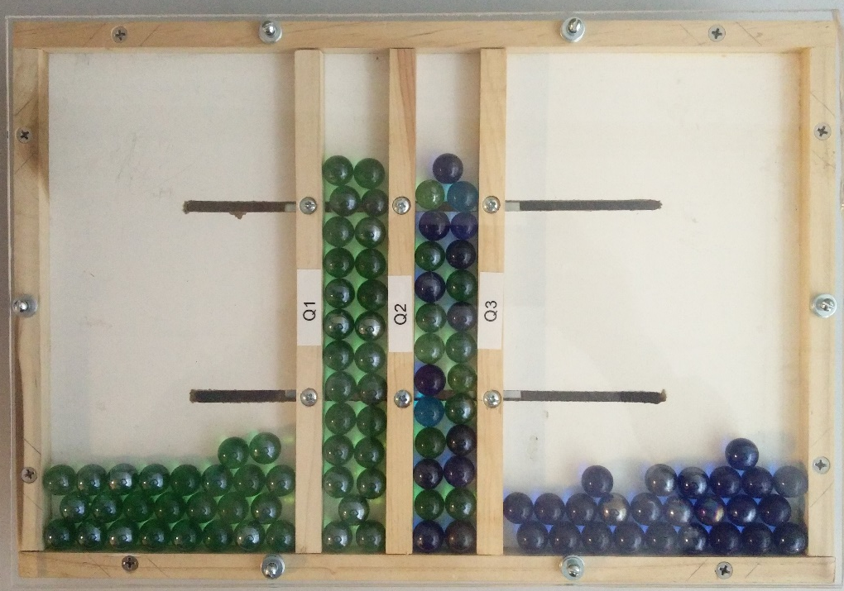
Normal-ish

Slide 46
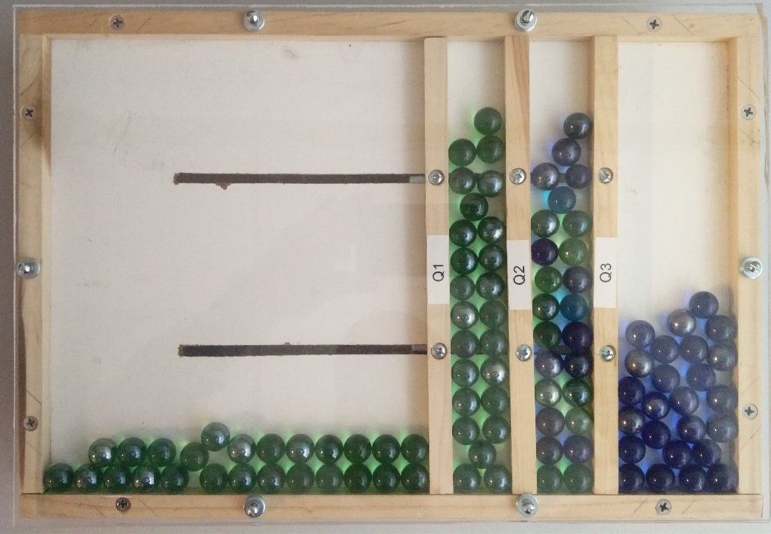
Skewed Left

Slide 47
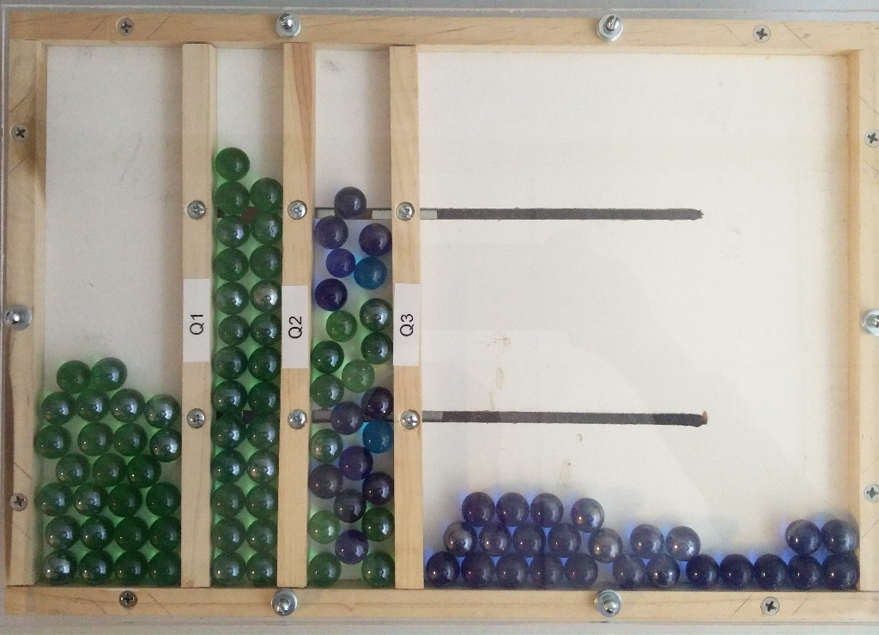
Skewed right

Slide 48

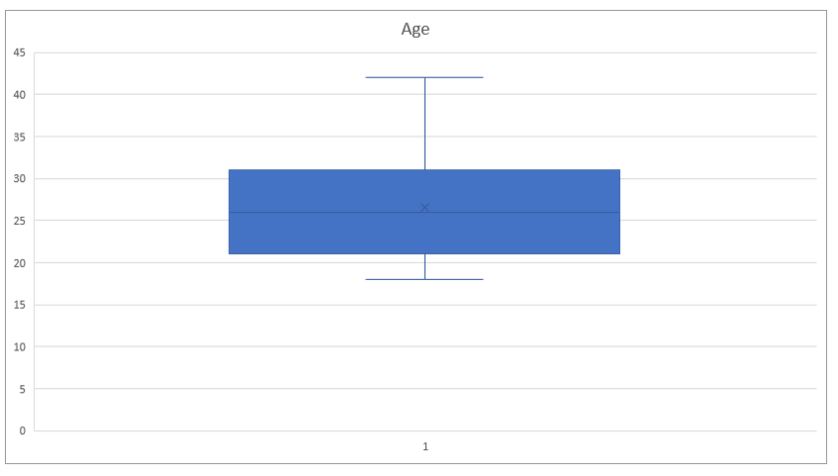


Slide 49
Comparing Graphics and and Testing Graphics
Different graphics are better at different things. Using them in pairs or triples can help increase student understanding.

Slide 50
Box plot is good at ….
Mean | Standard Dev | Sample Size
Mode | Range | Outliers
Median | IQR Skewness | Quartiles
Key
Highly effective:
Somewhat effective:

Slide 51

Histogram is good at ….
Mean | Standard Dev | Sample Size
Mode | Range | Outliers
Median | IQR Skewness | Quartiles
Key
Highly effective:
Somewhat effective:

Slide 52

Stem and leaf is good at ….
Mean | Standard Dev | Sample Size
Mode | Range | Outliers
Median | IQR Skewness | Quartiles
Key
Highly effective:
Somewhat effective:

Slide 53

Dot plot is good at ….
Mean | Standard Dev | Sample Size
Mode | Range | Outliers
Median | IQR Skewness | Quartiles
Key
Highly effective:
Somewhat effective:

Slide 54
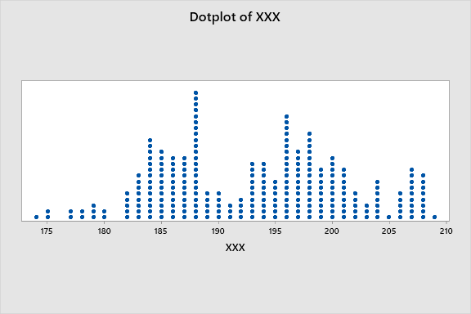
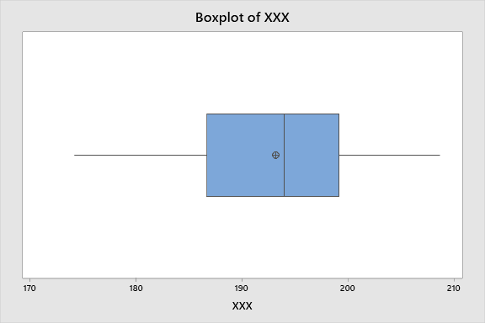
Comparing dot plots to box plots
n = 252,
63 data points in each quartile

Slide 55
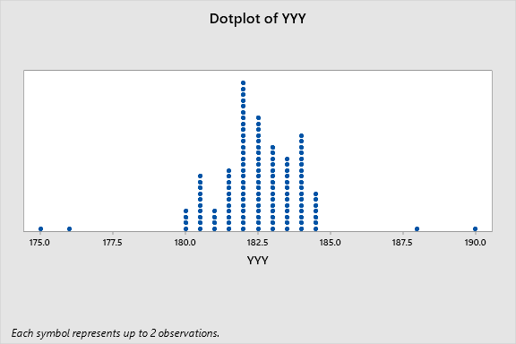
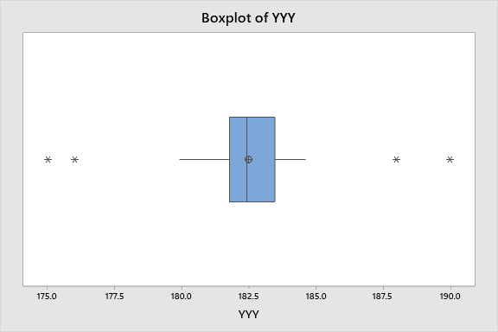
Comparing dot plots to box plots
n = 252,
63 data points in each quartile

Slide 56
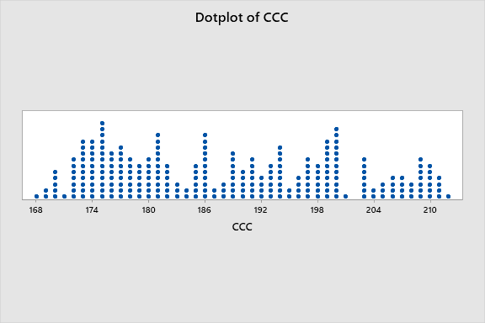
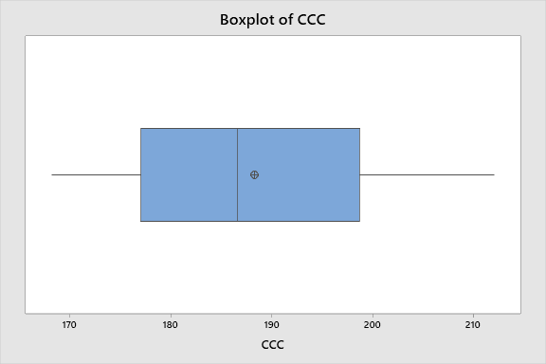
Comparing dot plots to box plots
n = 252,
63 data points in each quartile

Slide 57
Match the box plot with the dot plot testing students

Slide 58
Match the box plot with the dot plot

Slide 59
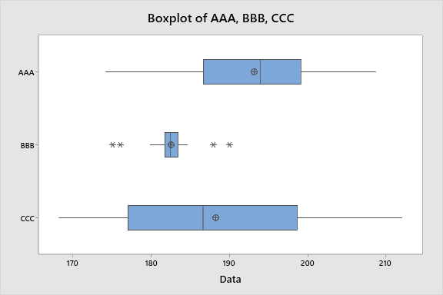
Comparing box plots

Slide 60
Questions regarding Copmaring Boxplots (previous slide)
Largest range?
Largest IQR?
Largest mean?
Largest median?
Most outliers?
Greatest skew left?
Greatest skew right?
Largest sample size (can’t tell)

Slide 61

Thanks for attending today!

