Slide 1
The Art of Questioning
Sister Cecilia Anne Wanner, O.P.
Middle Tennessee State University

Slide 3
How do you use Questioning in your classroom?
Think-pair-share
What role do questions currently play in your classroom?
What kind of questions do you typically ask?
How do you envision a classroom that employs strong questioning?

Slide 4
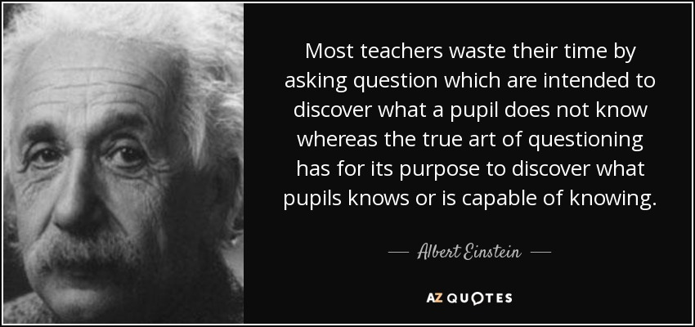

Slide 5
Questioning: Keep the Goal in Sight
What is the mathematical goal of the lesson?
Always keep this in mind!
Importance of wait time

Slide 6
Questioning: Essential Questions
What are the “essential questions” of the lesson?
Plan these out ahead of time
Purposeful
Aligned with instructional goals
Scaffolded

Slide 7
Questioning: Building Connections
Make connections
How does your answer fit into the big picture of what we are discussing?

Slide 8
Questioning: Multiple Solution Paths
Elicit alternative ideas and strategies
What is another way to approach this problem?
What are some different ways of thinking about this?

Slide 9
Questioning: When a student answers incorrectly …
Say more about that…
What do you mean when you say…?
Can you say that in another way or provide an example?

Slide 10
Questioning: Student Dialogue
Build on student responses
Encourage student-to-student dialogue
Can anyone say ______’s idea in a different way?

Slide 11
Let’s look at a classroom!
Using video to build questioning skills
Third-party videos
Personal videos
Peer observations

Slide 12
An online resource designed to provide teachers with records of best practice to improve their own teaching including:
Videos of Nationally Board certified teachers teaching real lessons in Pre-K through 12 classrooms
written commentaries
teachers’ notes
instructional materials
Notes:
ATLAS usage at our university:
PSTs and instructors have access.
We use ATLAS to prepare students for:
student teaching
edTPA
teaching as a profession

Slide 13
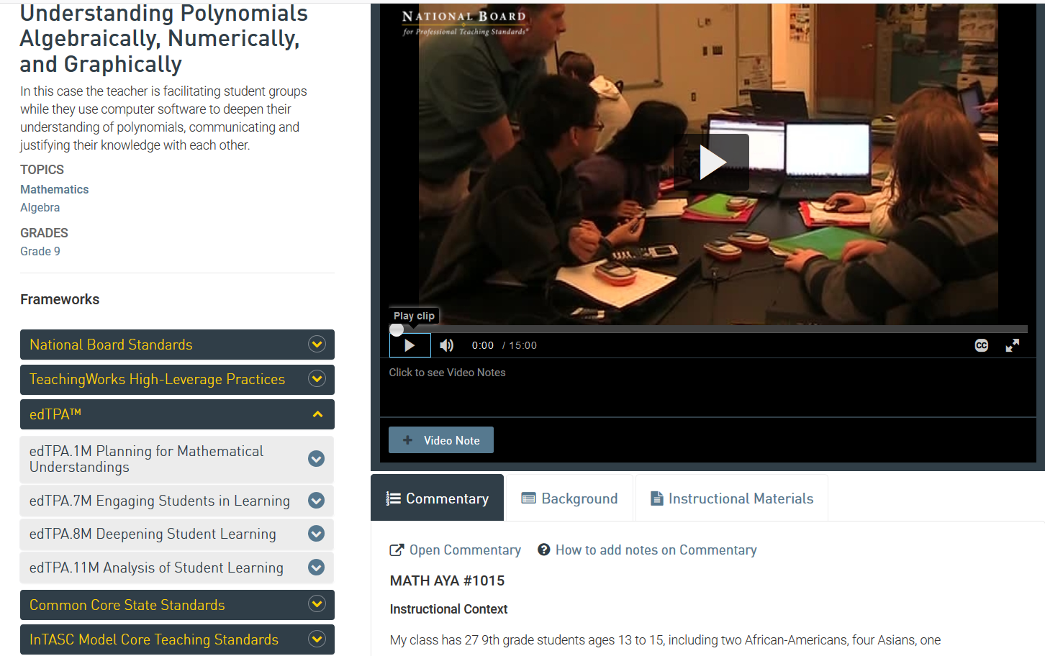
Exploring ATLAS
Notes:
https://atlas.nbpts.org/login?next=%2F
Case #1015

Slide 14
Analyzing a Lesson
9th Grade Algebra
Understanding Polynomials Algebraically, Numerically, and Graphically
ATLAS Case #1015
In this case the teacher is facilitating student groups while they use computer software to deepen their understanding of polynomials, communicating and justifying their knowledge with each other.
Goals for this lesson: 1) to recognize the degree of a polynomial in factored form; 2) to discover the relationship between the zeros of a polynomial and its factors; 3) discover the relationship between the zeros and the y-intercept; 4) find the effect of the leading coefficient on the graph and the y-intercept; 5) find the behavior at the zeros when a factor appears multiple times (multiplicity).
Notes:
Case #1015

Slide 15
Analyzing a Lesson
3rd Grade Math
Multiplication
Inside Mathematics Videos
http://www.insidemathematics.org/classroom-videos/number-talks/3rd-grade-math-one-digit-by-two-digit-multiplication/number-talk-part-1
In this number talk, Mia Buljan engages her third grade learners with a one-digit by two-digit multiplication problem, 5x14. She comments that her students have shown that while some numbers are easier for them to decompose (for example, tens and fives), with other numbers it is more difficult for students to mentally identify “friendly” numbers to use to help solve the problem. She invites students to share the different solutions they found, and then defend their thinking.
Notes:
http://www.insidemathematics.org/classroom-videos/number-talks/3rd-grade-math-one-digit-by-two-digit-multiplication/number-talk-part-1

Slide 16
“Good teaching is more a giving of right questions than a giving of right answers.”
~ Josef Albers

Slide 17
The Art of Questioning
Sister Cecilia Anne Wanner, O.P.
sjw3u@mtmail.mtsu.edu
Middle Tennessee State University

