Slide 1
Definitely Different Digits, Division Done Differently
Ryan Fox
Belmont University

Slide 2
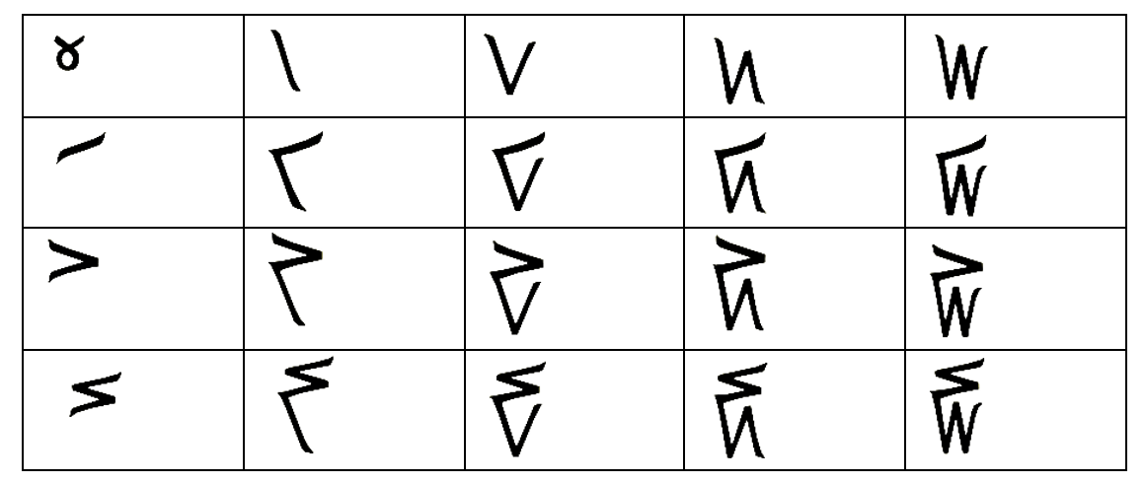
Let’s look at those different digits: Kaktovik numbers
What do you notice?
What do you wonder?
Just by the pictures, can you connect symbol to a value?

Slide 3
My current research (Fox, 2024, in preparation)
Looking at the Kaktovik addition expressions: $+$
Two different approaches in my study (Fox, 2024)
Natalie: “Symbol, English, English, English, Symbol”
Kate: Adding ones by appending strokes to the right and fives by extending strokes upward
What I am looking ahead to: multiplication (Ott, in progress) and division (TBD)

Slide 4
So... why division?!?
Already working on the other three operations
Interesting result on the internet: Native Alaskan students ”visualize” division much better in this number system, better than the “traditional” (Hindu-Arabic) numbers. Such visualization has pay off in making up for gaps in achievement test scores.

Slide 5
$$×$$

Slide 6
Let’s try it out!

Slide 7
Thank you so much!
Email: ryan.fox@Belmont.edu
Quasi-professional Insta and Twitter: @drfoxatbu
Link to today’s presentations: http://bit.ly/mtmtryanfox2024

