Slide 1
Quantitative Reasoning meets #adulting: Mathematical Content and Real-World Context
Ryan D. Fox
Belmont University

Slide 2
How it started..

Slide 3
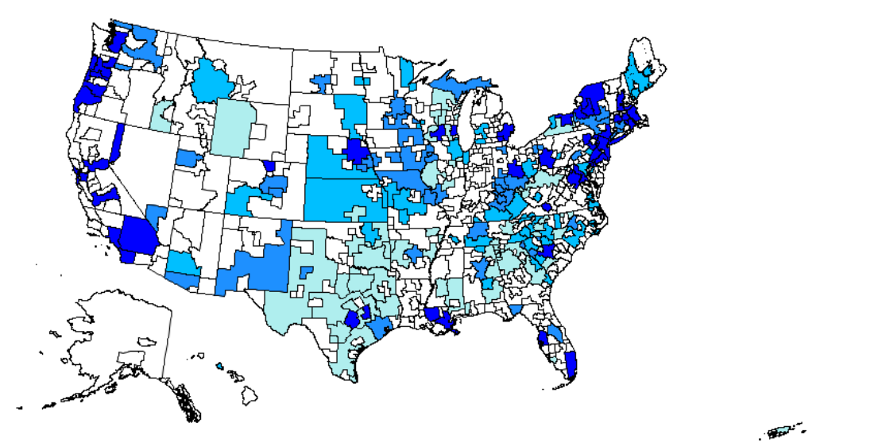
A first adjustment: Get a job!
Using data from the Bureau of Labor Statistics website, I have the students identify a potential career and three areas in America to live in.
Site: https://www.bls.gov/oes/current/oes_nat.htm

Slide 4
My Example…
Location | Nashville, TN | Philadelphia, PA | Atlanta, GA
25th Percentile Salary for a Postsecondary Mathematics Teacher in this Location | $50,330 | $59,190 | $42,800

Slide 5
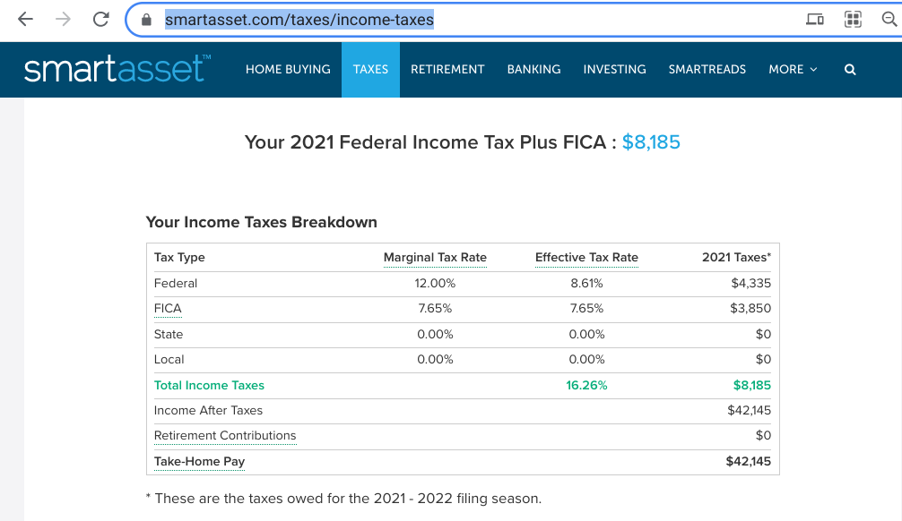
Make it more relevant: Pay taxes!
Trying to find an up-to-date income tax calculator can be a little challenging! However, this site has been one of the more trusty sites for my students and me! I need a site like this to identify all three types of income taxes in America: federal, state, and local!
Site: https://smartasset.com/taxes/income-taxes

Slide 6
Discussion opportunities: Math and Federal Income Taxes
Challenge in teaching income taxes: the rules and formulas change every year.
…and the discussion: when to use the table? When to use formulas? Why is it different?
Site: https://www.irs.gov/pub/irs-dft/i1040tt--dft.pdf

Slide 7
My Example…
Location | Nashville, TN | Philadelphia, PA | Atlanta, GA
25th Percentile Salary | $50,330 | $59,190 | $42,800
Federal Income Tax | $4,335 | $6,009 | $3,431
FICA “Tax” | $3,850 | $4,528 | $3,274
State Income Tax | $0 | $1,817 | $1,869
Local Income Tax | $0 | $2,323 | $0
After-tax Salary | $42,145 | $44,513 | $34,226

Slide 8
Looking ahead: Houses!

Slide 9
My Example…
Location | Nashville, TN | Philadelphia, PA | Atlanta, GA
25th Percentile Salary | $50,330 | $59,190 | $42,800
Monthly Salary | $4194 | $4932 | $3566
Money available for housing per month | $1174 | $1381 | $998
Example house payment | $1109 | $961 | $952

Slide 10
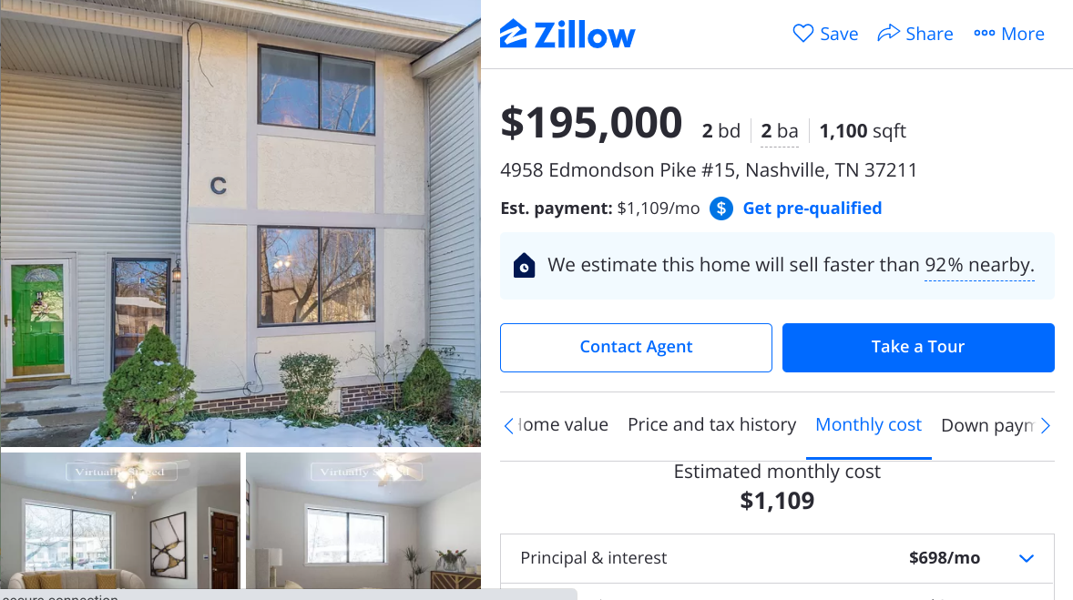
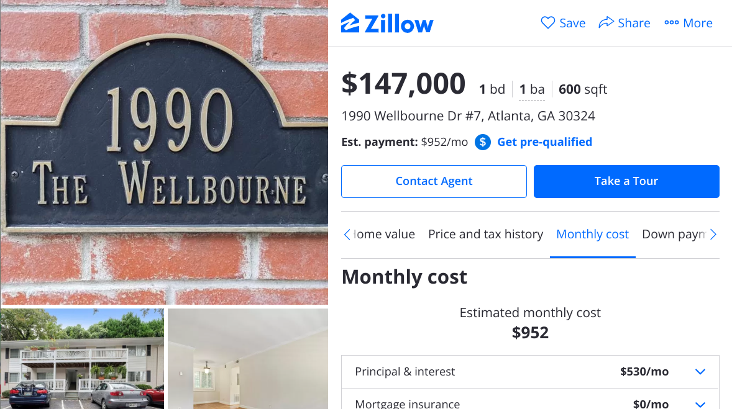
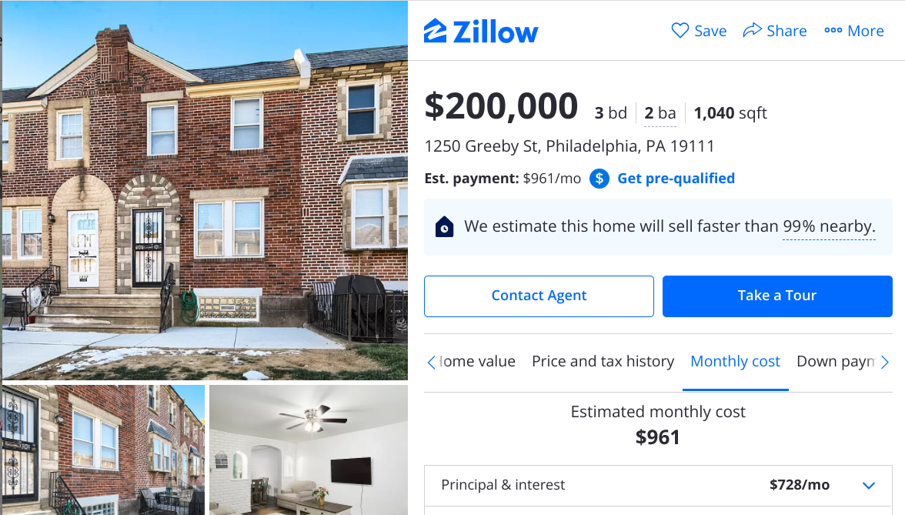
Look at what I found!
A 1100 square foot 2 bed/2 bath townhouse in Nashville for $1,109/month
A 600 square foot 1 bed/1 bath condo in Atlanta for $952/month.
A 1040 square foot 3 bed/2 bath townhouse in Philadelphia for $961/month

Slide 11
Costs of living! Site: livingwage.mit.edu, unless italicized
Category | Nashville, TN | Philadelphia, PA | Atlanta, GA
Salary | $50,330 | $59,190 | $42,800
Food | $3,177 | $3,690 | $3,177
Medical | $2,813 | $2,729 | $2,713
Housing | $13,308 (yearly!) | $11,532 (yearly!) | $11,424 (yearly!)
Transportation | $5,113 | $4,332 | $5,113
Civic | $1,811 | $1,702 | $1,811
Other | $2,875 | $3,078 | $2,875
Taxes | $8,185 (adds up!) | $14,677 (adds up!) | $8,574 (adds up!)
Total Expenses | $37,282 (74.1%) | $41,740 (70.5%) | $35,687 (83.4%)
Remaining Salary | $13,048 | $17,450 | $7,113

