Slide 1
Number Sense with Place Value Lessons
Wendy Comer
Spring 2019

Slide 2
Presentation
The basics of number sense with unique place value lessons involving
movement, multiplication, decimals, and games.

Slide 3
Modifications
Any activity mentioned is not grade specific – all may be modified to work with the grade level you are teaching and the student’s abilities

Slide 4
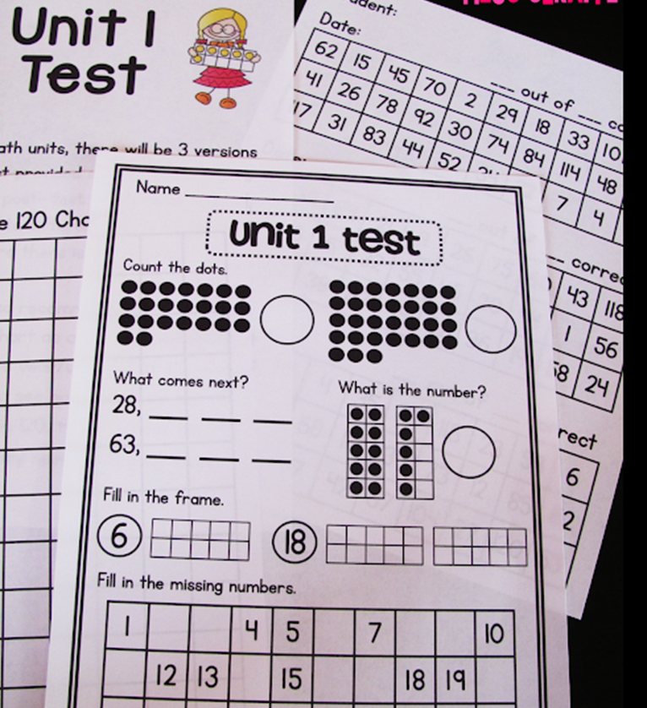
Kindergarten
Roll on – roll a dice then write the next two numbers down (or subtract the next two numbers)
10 Frames – able to recognize number immediately – can use paper or egg cartons
Grab it – estimate the amount and then count the actual number
Is it more or less than your estimate?
How do you know?
Circle Counting
Centers to practice counting

Slide 5
Kindergarten (continued)
Student addition
Student is assigned a number and then add other students on to make a new number
Number assigned to student who doesn’t know the number and class must give clues to student to determine that number
Can you make that number another way?
Stack It
Connect your new cubic stack to a previous one. Can you do it without it falling over? If it does, you start over.

Slide 6
First Grade
Regrouping unit blocks into blocks of ten
Emphasizes relationships between the groups of blocks and the corresponding digits in a two digit number – also gives practice in counting

Slide 7
First Grade (continued)
Blank 120 charts – race to fill in with a partner – need to use different inks
Any kindergarten activities to be used as review

Slide 8
Second Grade
Place Value by Number Rock
https://www.youtube.com/watch?v=a4FXl4zb3E4

Slide 9
Third Grade
Modify any of the previous lessons

Slide 10
Fourth Grade
Places Everyone
Use knowledge of place value to order numbers from least to greatest
Sheet of paper with blanks for a nine digit number
Ice breaker questions such as “What is the first digit in your address” and “What is your shoe size?”
Write one answer in each blank on their paper. Add commas so easier to read.
Line up from least to greatest.
Can also use only four or five questions and digits to make numbers easier.
For fifth grade – may also add decimal points

Slide 11
Fourth Grade (continues)
Live Number Line
Apply knowledge of place value to order and compare numbers
Give each student a note card with a different numeral between 0 and 1 expressed in decimal form.
Have students line up least to greatest. Record.
Create a number line of 0 to 1 on the wall.
Have students use sticky notes to label tenths and then hundredths on the number line.
Have students line up again from least to greatest.

Slide 12
Fifth Grade
The Race to One
Applying understanding of tenths, hundredths, and thousandths to build one whole
Need the following – sheet of drawing paper, mini-white board and marker per student, colored pencils, ruler, calculator, set of two dice per pair of students – one standard and one with two sides each showing the following 1/10, 1/100, 1/1000.
Students divide their sheet into two rows of five equal rectangles. All ten rectangles represent the number one and the first student in each pair to color the whole sheet will win.
Roll the dice and multiply the two numbers (6 x 1/100 = 6/100 = .06) Color in the corresponding number of parts on their rectangle sheets.
To check their work, students will add the decimals recorded on their whiteboards to make sure the answer equals one.

Slide 13
Books that Build Number Sense
How much is a Million? By David M. Schwartz
Sir Cumference and all the King’s Tens: A Math Adventure by Cindy Neuschwander
Zero the Hero by Joan Holub
Number Talks: Fractions, Decimals, and Percentages by Sherry Parrish and Ann Dominick
Give Me Half by Stuart Murphy
A Fraction’s Goal – Parts of a Whole by Brian Cleary
How Many Seeds in a Pumpkin? by Margaret McNamara (estimation)
One is a Snail, Ten is a Crab by April Sayre (skip counting)
How Many Feet in the Bed? by Diane Hamm (skip counting)
98, 99, 100! Ready or Not, Here I Come! by Teddy Slater (counting)

Slide 14
References
https://www.k5learning.com/free-math-worksheets/first-grade-1/base-ten-blocks
https://missgiraffesclass.blogspot.com/2015/07/building-number-sense-in-first-grade.html
https://proudtobeprimary.com/childrens-books-teaching-math/
Place Value by Number Rock https://www.youtube.com/watch?v=a4FXl4zb3E4
Scholastic Teacher Back to School Issue 2018, pg. 60-61.

