Slide 1
Math Technology: Are you up to date?
Ali Rather, Lindsey Spathelf, and Kelsey Hudson

Slide 2
Microsoft Pen Tool

Slide 3
Microsoft Pen Tool
Compatible with Microsoft Office (Word, PowerPoint, Excel, etc.)
Converts any document into a document that teachers and students can write on using technology.
Select Customize Quick Access Tool Bar (typically located at the top of your screen)
Click More Commands
Under the Customize Quick Access Tool Bar Tab, change Popular Commands to All Commands
Scroll down to find the Pen application—these are in alphabetical order
Select the Pen icon and click Add>> (this will allow for easy access in the future—you should only have to do this once)
How can I get this?

Slide 4
Nearpod

Slide 5
Create interactive lessons in minutes
Save prep time by easily importing existing lessons (pdfs, jpegs, ppts) and adding interactive features such as Virtual Field Trips, 3D Objects, Quizzes, Polls, Open Ended Questions + more!
Easily download & customize ready-to-run lessons
Choose from thousands of free or paid lessons from expert educators and our educational partners. Customize any lesson to fit your students’ needs.

Slide 6
www.nearpod.com
Synchronize and control lessons across all student devices
Teachers share a live session, students enter a code, and the lesson is synced to all devices
Enables 100% student participation

Slide 7
Highlights of Nearpod
Find or create lessons
Interact with your students
Get student insight
Lessons for all subjects
Over 6,500 ready- to- run, customizable lessons build in partnership with publishers like PhET and ReadWorks.

Slide 8
quizizz

Slide 9
Quizizz is a review tool
www.quizizz.com
Quizizz is a free tool. It works on any device: web browser, iOS, Android and Chrome apps. You can access hundreds of ready-made learning quizzes or create your own. Join as a teacher, pick a quiz, and use the code for a virtual room to give to your students.

Slide 10
Highlights of Quizizz
You can search and find an already made quiz. You can duplicate and add it to “My Quizizzes.”
You can make edits to questions or add/delete questions as needed.
Live Game → post a code and everyone plays at once
Homework Game → give code or post as a link and set a due date for when it needs to be completed by
Students can answer at their own pace unlike Kahoot

Slide 11
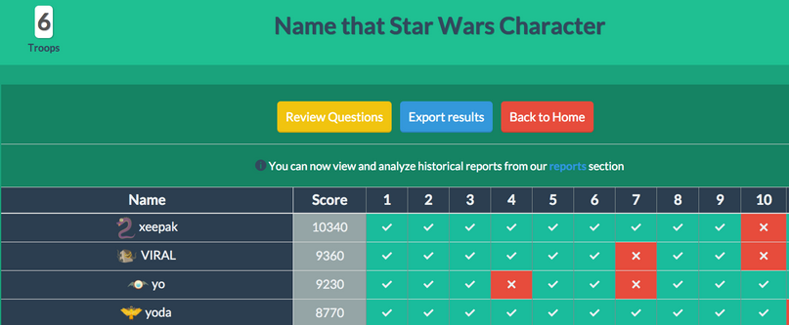
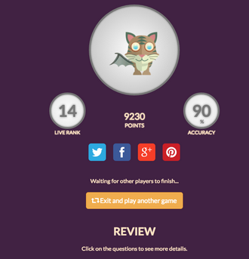
Quizizz Features
Question Set-Up
Multiple Choice with 4 answer options
Easy display of results
Can export results
Students can see the correct answers when they finish the quizizz
Able to easily review most missed questions as a class

Slide 12
TI Education

Slide 13
TI Education
https://education.ti.com/en/resources/math
Texas Instruments Education provides resources for middle grades through high school mathematics. You are able to access resources designed to develop students’ higher order thinking abilities and conceptual understanding.

Slide 14
Highlights of TI Education
Classroom Activities
Building Concepts in Mathematics
NCTM Principles to Actions
TI Codes
TEKS-aligned activities
CCSS-aligned activities
TI in Focus
https://education.ti.com/en/resources/math

Slide 15
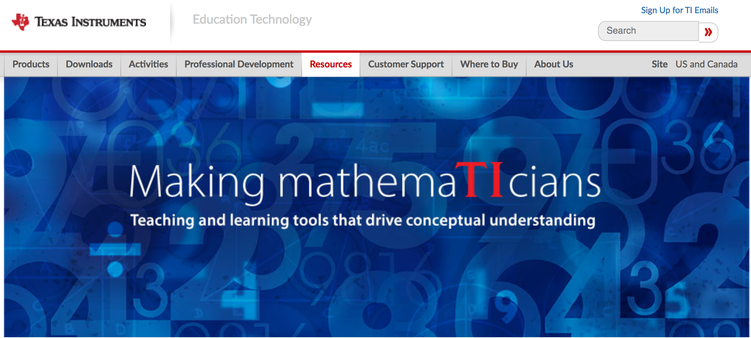
TI Education-Professional Development
On-site workshops
On-demand Webinars

Slide 16
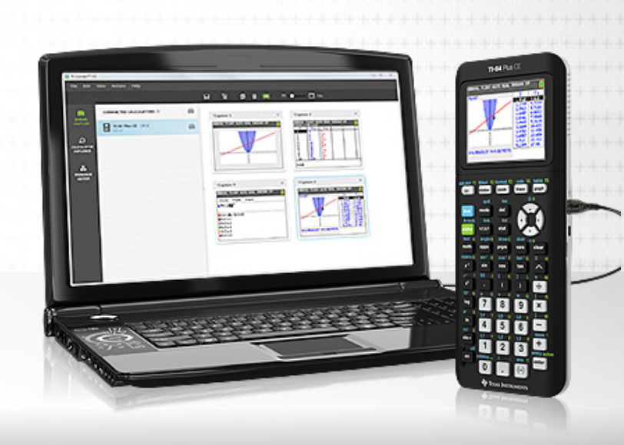
TI in Your Classroom
Free Software Trials
Test Prep Tools
TI Technology Rewards

Slide 17
Prodigy

Slide 18
Review Tool
www.prodigy.com
Prodigy is a curriculum-aligned math platform, used by 800,000 teachers and 30 million students, that allows admins to quantify student achievement with ease
Prodigy is a free, Pokemon-style math game that has been proven to improve student scores and confidence! It is for grades 1-6, and features content from each of the five major strands

Slide 19
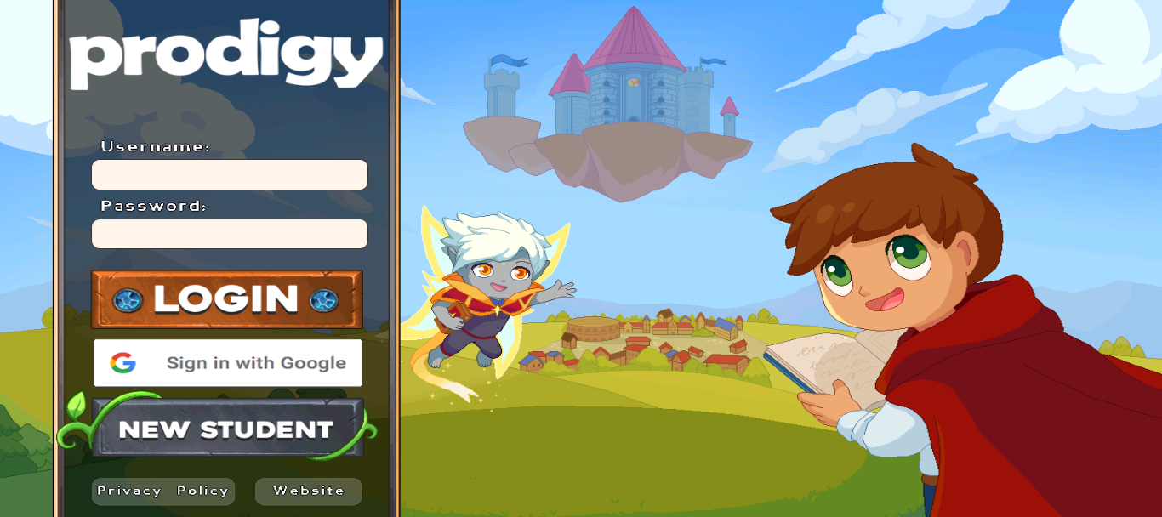
Prodigy Features
To create deep engagement so students can double their math practice time at home
To equip teachers with reports and assessment tools to inform their instruction.
To provide curriculum aligned content for free, regardless of a student’s demographic.

Slide 20
vidyard

Slide 21
https://www.vidyard.com/govideo/
This is a Google Extension that can only be used in your Google Chrome browser.
Vidyard GoVideo is a free Google Chrome add on that acts as a video and webcam recorder. It allows you to capture your screen, record your front-facing camera, voice record and share with a simple link.
Great for recording read aloud tests and video lessons when you are out with a substitute.

Slide 22
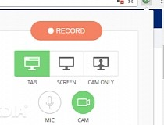
Vidyard Features
Videos can be shared with a simple link through email or by posting on google classroom or any other communication method used with your students
Unlimited FREE videos
Recording limit is 1 hour per video

Slide 23
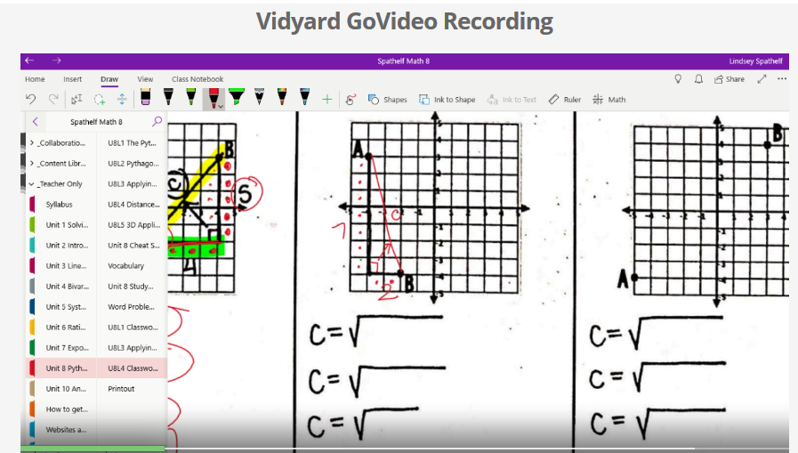
Vidyard Examples
Distance between Two Points Lesson
https://share.vidyard.com/watch/vTQ77EpZyCcesGto5HZXzh?
Unit 8 Assessment Read Aloud
https://share.vidyard.com/watch/VtdezhE8gNifV7MsYEtmqD?

Slide 24
Desmos

Slide 25
Desmos
https://www.desmos.com/
Desmos is a free tool that allows you to quickly graph functions, plot data, evaluate functions, explore transformations, and much more!

Slide 26
Highlights of Desmos
You can easily pull up a large screen graphing tool so that the entire class has the ability to see and discuss material.
You can set up a Teachers Desmos Account to create virtual activates for students to participate in and complete.
Great for discovery learning involving transformations and behavior of functions.

Slide 27
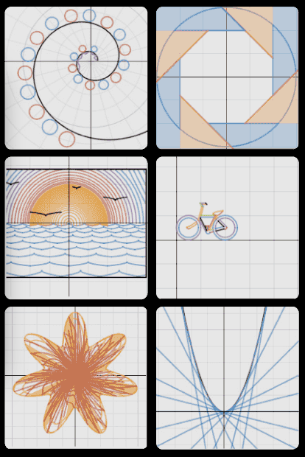
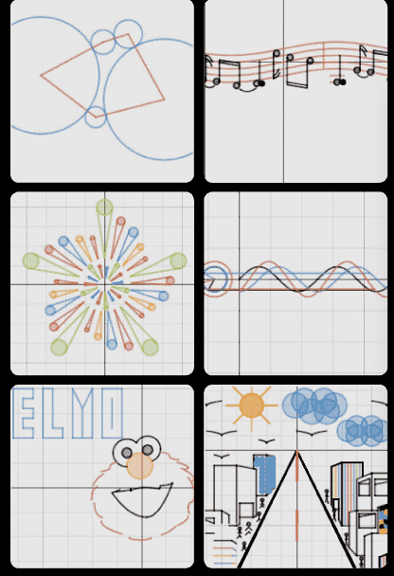
Desmos
https://teacher.desmos.com/
Premade Classroom Activites
Create Classroom Activities

Slide 28
Math technology: are you up to date?
Padlet

Slide 29
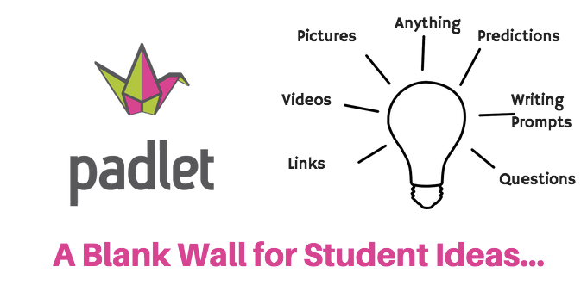
Padlet
Make beautiful boards, documents, and webpages that are easy to read and fun to contribute to.
Click on the link and share ideas of how you will use some of the technology resources we talked about today with your students.

