Slide 1
Middle Tennessee Mathematics Teachers
Math for All Seasons
February 23rd, 2019
Pope John Paul II High School
Hendersonville, TN
Middle School Stats is Where It’s At!
Dr. Jennifer Yantz
Austin Peay State University, Clarksville, TN
Christina Ploeckelman
7th Grade, Richview Middle School, Clarksville, TN

Slide 2
Did you ever read a standard and think……………
WHAT ??????

Slide 3
What are some of the 6-8 Statistics Standards that you have questions about?

Slide 4
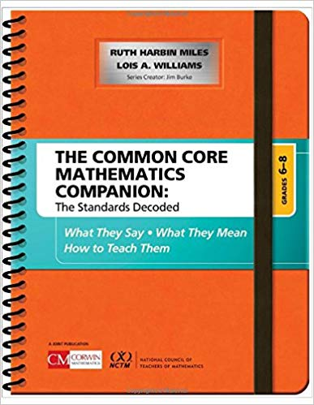
Resources for Making Sense of Standards
Tennessee State Instructional Focus Documents
NC Standards Unpacked
http://www.ncpublicschools.org/curriculum/mathematics/scos/current/#unpacking
The Common Core Mathematics Companion
Grades 6-8 The Standards Decoded
CCSS Mathematics Progression Documents
http://ime.math.arizona.edu/progressions/

Slide 5
Statistics Task Based Lessons
Cover multiple standards/sub-parts
Incorporate Standards for Mathematical Practice

Slide 6
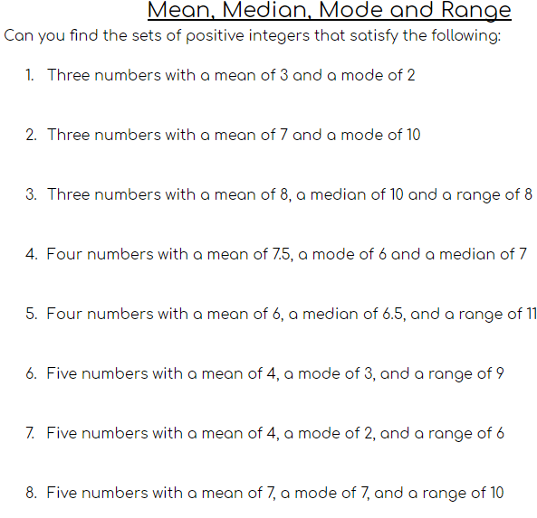
Statistics Tasks Mean, Median, Mode, and Range Open Middle Problems 6.SP.A.2 & 3 7.SP.D.8.a

Slide 7
Statistics Tasks Mean, Median, Mode, and Range Open Middle Problems 6.SP.A.2 & 3 7.SP.D.8.a
Let’s try one:
Give five values that have a mean of 30 and a median of 36.

Slide 8
Statistics Tasks Show conceptual understanding of “mean” 6.SP.A.3 & 5 7.SP.D.8.a & b 7.SP.B.4
The mean weight of three cats is 14 pounds. Which of the following is possible? (Answer Y for Yes or N for No)
_____(a) One of the cats weighed 20 pounds.
_____ (b) None of the cats weighs more than 14 pounds.
_____ (c) Each cat weighs less than 14 pounds.
_____ (d) The cats weigh 14, 18, and 10 pounds.
_____ (e) The cats weigh 13, 18, and 8 pounds.
_____ (f) Altogether, the three cats weigh 50 pounds.

Slide 9
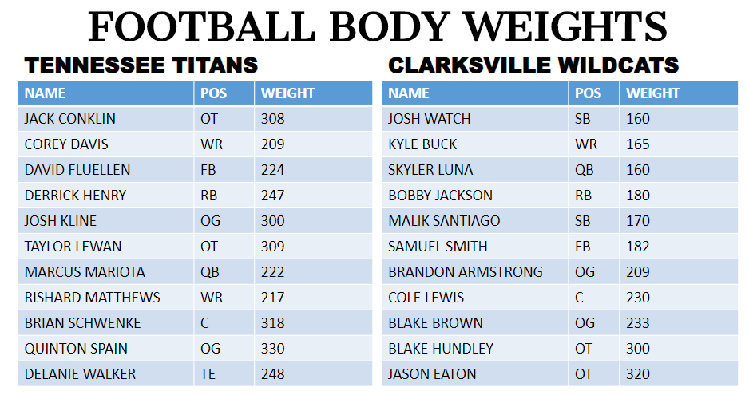
Statistics Tasks Working with Data Sets 6.SP.A.1 6.SP.A.2 6.SP.A.3 6.SP.A.4 6.SP.A.5.a 7.SP.B.3 7.SP.B.4 7.SP.D.8.a
Notes:
Could we talk about paper folding for five number summary here?

Slide 10
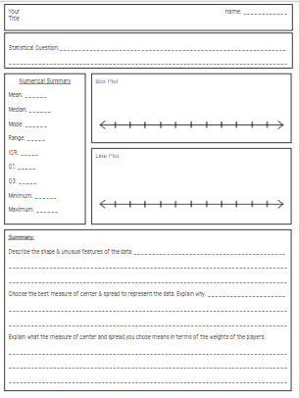
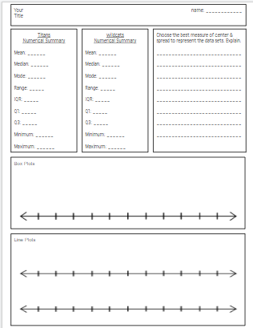
Statistics Tasks Working with Data Sets 6.SP.A.1 6.SP.A.2 6.SP.A.3 6.SP.A.4 6.SP.A.5.a 7.SP.B.3 7.SP.B.4 7.SP.D.8.a

Slide 11
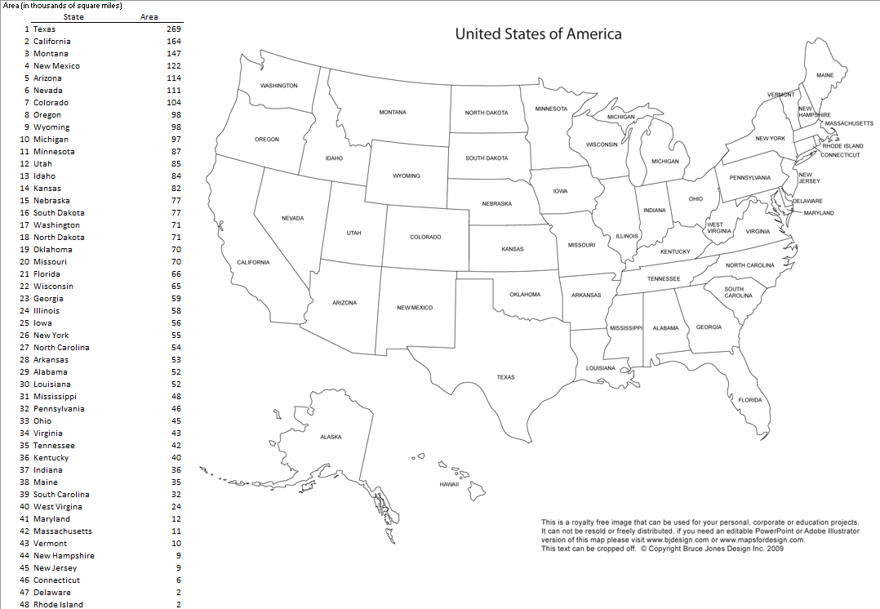
Statistics Tasks Working with Data Sets Grade 7 7.SP.A.1 7.SP.A.2
Sampling Methods
Notes:
Illustrative Mathematics
https://tasks.illustrativemathematics.org/content-standards/7/SP/A/tasks/260

Slide 12
Statistics Tasks Sampling from Populations Grade 7 7.SP.A.1 7.SP.A.2
Sampling Methods
Select various samples of size 10 and try to predict the true population mean area (in thousands of square miles) of the 48 states.
Random
generate random numbers and select from the list
close eyes and point to a state
Systematic
generate a random number from 1 to 4. Start at that state and take every 4th state.
Stratified
divide the states into 5 regions and select 2 from each one
Cluster
divide the states into 5 regions and select all from one randomly selected region.
Compare all sample means to the true mean area of 65,000 square miles.

Slide 13
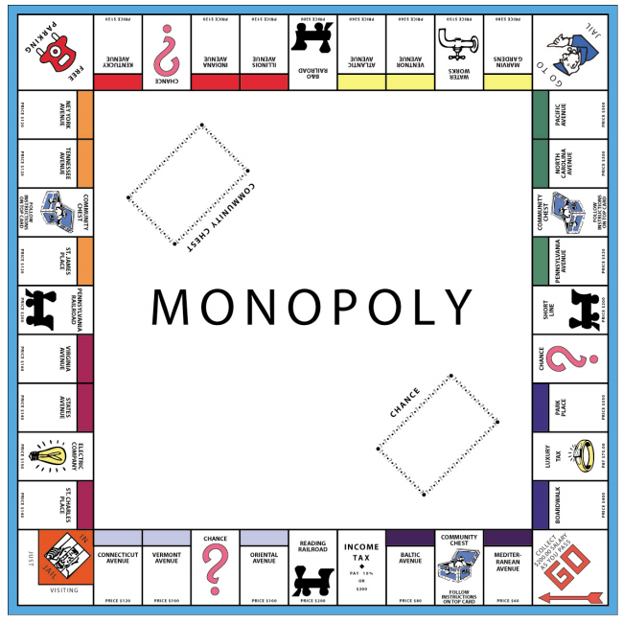
Statistics Tasks Patterns of Association Grade 8 8.SP.A.1 8.SP.A.2 8.SP.A.3

Slide 14
Statistics Tasks Patterns of Association Grade 8 8.SP.A.1 8.SP.A.2 8.SP.A.3
Is there a relationship between a property’s cost and its distance from GO? If so, how can the relationship be used to predict the cost of new properties?
Task Summary:
Create a table of property values and the number of spaces a property is from GO
Create a scatterplot of the bivariate data
Assess the relationship visually
Draw a line of best fit
Given an equation, interpret the slope and y-intercept in the context
Make predictions for values of new properties

