Slide 1
Establishing a Growth Mindset in the Mathematics Classroom
Lindsey Hinds-Brown, lindsey.hindsbrown@wcs.edu
Jaelle Johnson, jaelle.johnson@wcs.edu
Notes:
2 min

Slide 2
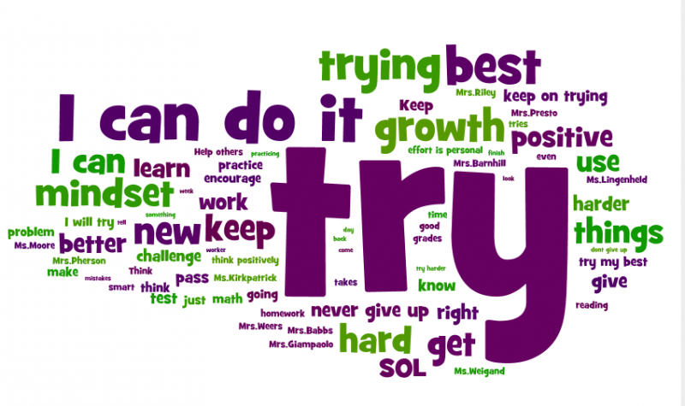
Agenda
Mindset in the Classroom
What is Growth Mindset?
Fixed vs. Growth Mindset
Identifying Your (or Your Students’) Mindset
Help Students Develop a Growth Mindset
Growth Mindset in the Math Classroom
Notes:
2 minutes

Slide 3
Mindset in the Classroom
Education Week Research Center
Mindset in the Classroom: A National Study of K-12 Teachers
Notes:
3 minutes

Slide 4
What’s Your Classroom Mindset?
http://blog.mindsetworks.com/what-s-my-classroom-mindset
Notes:
8 min

Slide 5
What is Growth Mindset?
Notes:
4 min

Slide 6
Fixed vs. Growth Mindset
Notes:
4 min

Slide 7
How to Help Your Students Have a Growth Mindset
It starts with you…
Teach your students about Growth Mindset
Believe in your students, and tell them so!
Help them to change their self-talk
Recognize, and communicate often, that failure is necessary for success
Praise effort over outcomes; celebrate mistakes!
Educate parents
Notes:
3 min

Slide 8
It Starts With You…
Paper surveys
PERTS Growth Mindset Assessment https://survey.perts.net/share/toi
Never tell your student’s that you’re not good at something… just say that it was something you never worked very hard at
Be willing to make mistakes in front of your students—you can even reward them if they catch you make one!
Notes:
10 min

Slide 9
Student Videos to Teach Growth Mindset
Elementary School
Middle School
High School
2:35
2:57
5:05
Notes:
5 min

Slide 10
Believe in Your Students
4:55
Notes:
6 min
In one study (Yeager et al, 2013) researchers worked with high school students who were divided into 2 groups. All students wrote an English essay and received critical feedback on their essay from their teachers, but half of the students – and the teachers did not know who they were – received an extra sentence. The sentence was: “I am giving you this feedback because I believe in you” The students who received this sentence achieved at higher levels on school tests a year later.

Slide 11
Growth Mindset Self-Talk
Notes:
4 min

Slide 12
Failure is Important
Famous Failures
Meet the Robinsons
2:59
1:02
Notes:
5 min

Slide 13
Praise Effort; Celebrate Mistakes
When students get an answer correct in class, be happy for them.
When students get an answer wrong… don’t give up on them and go to another student. Let them persevere through their thinking—understanding their mistake and finally getting it. Then, applaud! They learned something new! Celebrate their “brain growth.”
This adjustment promotes and fosters a safe learning environment for all students. Students are not afraid to raise their hand or make mistakes!
This idea transforms the culture of a classroom, particularly for struggling students.
Notes:
5 min

Slide 14
Educate Parents
At Parent Night, forget the syllabus. Educate them about Growth Mindset instead!
Encourage them to use positive words about math instead of saying “I was never any good at math.”
If parents have math anxiety, ask them not help with homework!
Notes:
5 min

Slide 15
Growth Mindset in the Math Classroom
Dr. Jo Boaler, Professor of Mathematics Education at Stanford University; @joboaler
Books: Mathematical Mindsets, What’s Math Got to Do With It?, and more.
Youcubed.org; #youcubed; also on Facebook
Notes:
3 min

Slide 16
YouCubed.org
Ideas around Number Sense, Visual Math, Ability Grouping, Assessment, Depth not Speed, and more
Math Tasks that promote mathematical thinking
Week of Inspirational Math
Videos
Online Courses
Evidence & Research
Parent and Student Resources
Notes:
3 min

Slide 17
Week of Inspirational Math
Activities and Videos
In previous years of WIM, 96% of the students surveyed said they now believe they should keep going even when work is hard and they make mistakes.
Notes:
5 min

Slide 18
Classroom Norms
Everyone can learn math to the highest levels
Mistakes are valuable
Questions are really important
Math is about creativity and making sense
Math is about connections and communicating
Math class is about learning not performing
Depth is more important than speed
Notes:
3 min

Slide 19
Resources for Continued Learning
Books:
Mindset by Carol Dweck
Mathematical Mindsets by Jo Boaler
Youcubed.org: Online Teacher Courses
Mathematical Mindsets ($99, self-paced)
How to Learn Math for Teachers ($99, self-paced)
Youcubed.org: Online Student Course
How to Learn Math (free!)
http://mashupmath.com/growth-mindset-resources/
https://www.amazon.com/gp/withmathican
http://www.growthmindsetmaths.com/
Notes:
5 min

