Slide 1
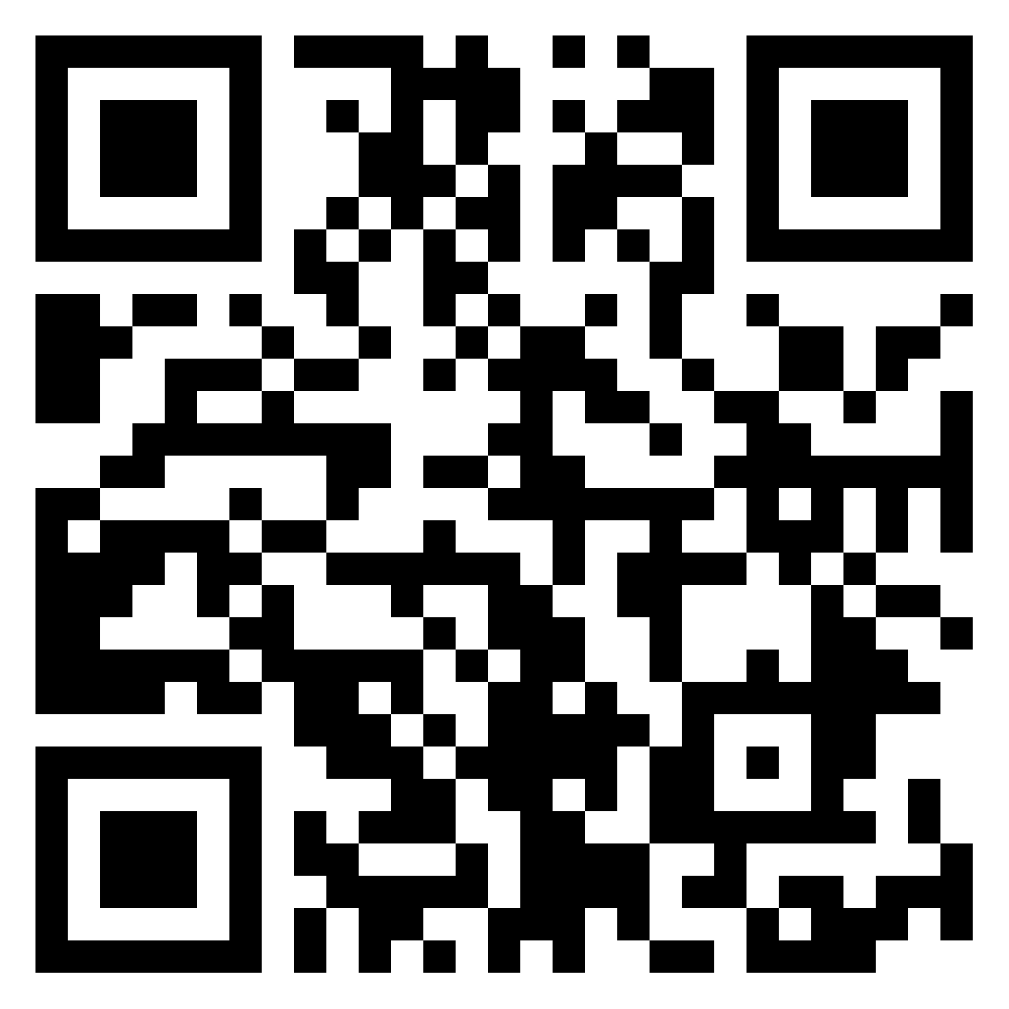
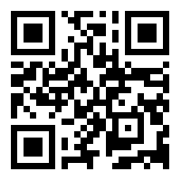
How to Put the M in STEM!
Google Classroom
Class Code: 43tldfk
Padlet
Erin Nunley & Cherry Ross

Slide 2
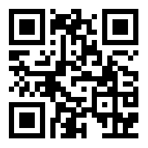
Jamboard Link

Slide 3
Goals
Establish an entry point on how to integrate using math tasks while using real-world concepts and pairing with grade level standards.
Learn the steps to create integrated math tasks.

Slide 4
“Good problem solving tasks require students to get stuck and then to think, to experiment, to try and to fail, and to apply their knowledge in novel ways in order to get unstuck.”
Building Thinking Classrooms in Mathematics
By Peter Liljedahl

Slide 5
Engagement

Slide 6
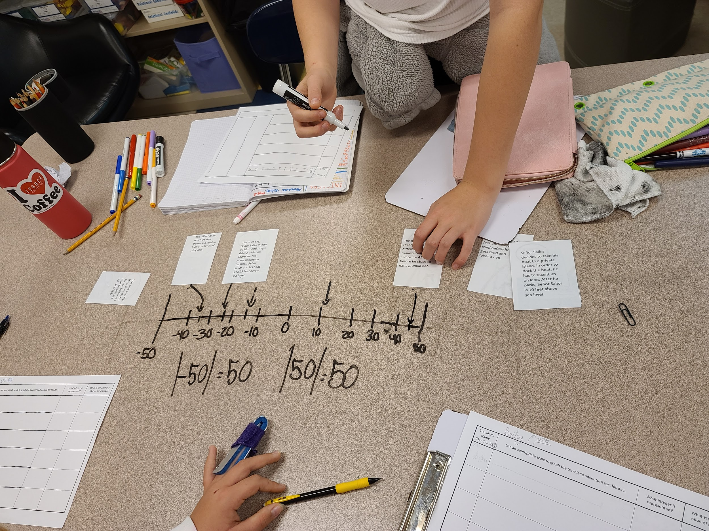
Student’s Perspective- How do you feel about math tasks?
“I feel I'm succeeding in class and it's better for me to learn through tasks rather than working from a textbook.” - Davis
“I enjoy it because I can learn more than one thing at a given time.” Anderson

Slide 7
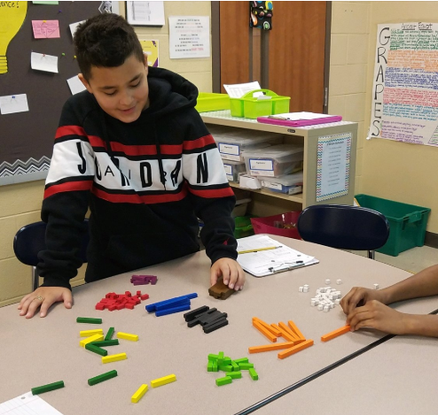
Student’s Perspective- How do you feel about math tasks?
“Everyone seems to do better in class and I feel I'm better at seeing word problems, where they're coming from, and how it relates to ELA and other subjects.” Hayden
“I like it because they're more fun to learn from.” Tara

Slide 8
Science and Engineering Practices (SEPs)

Slide 9
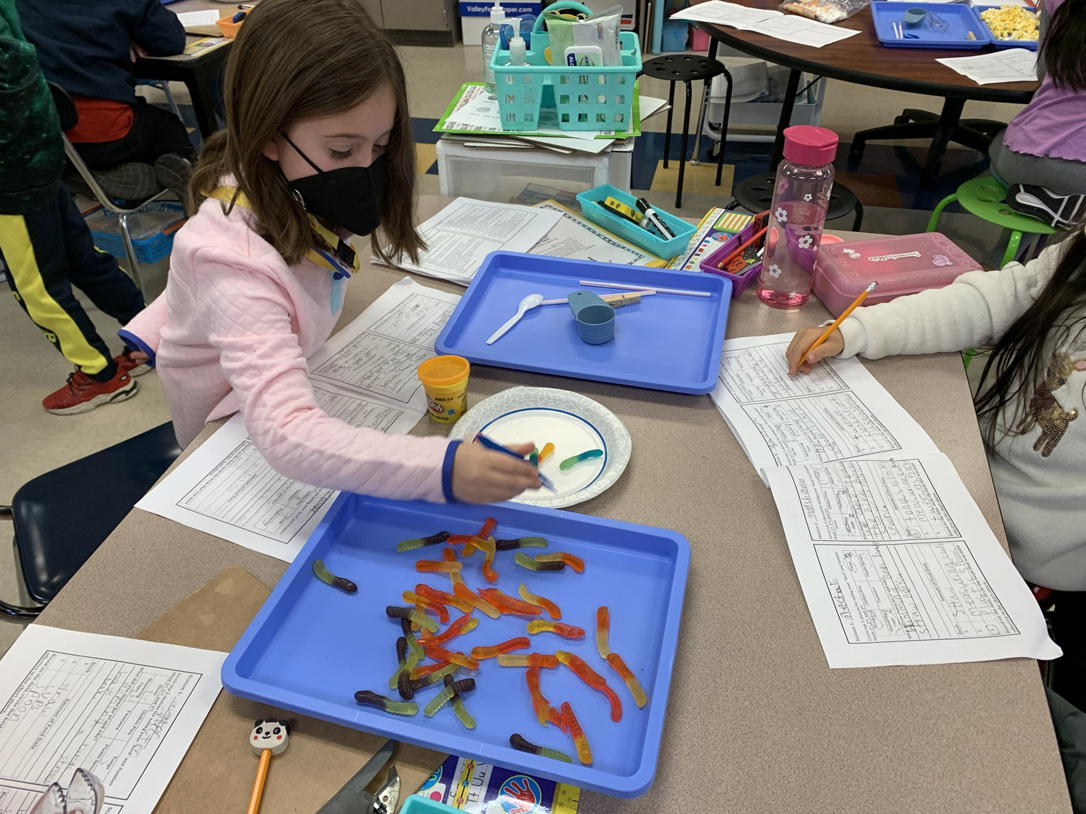
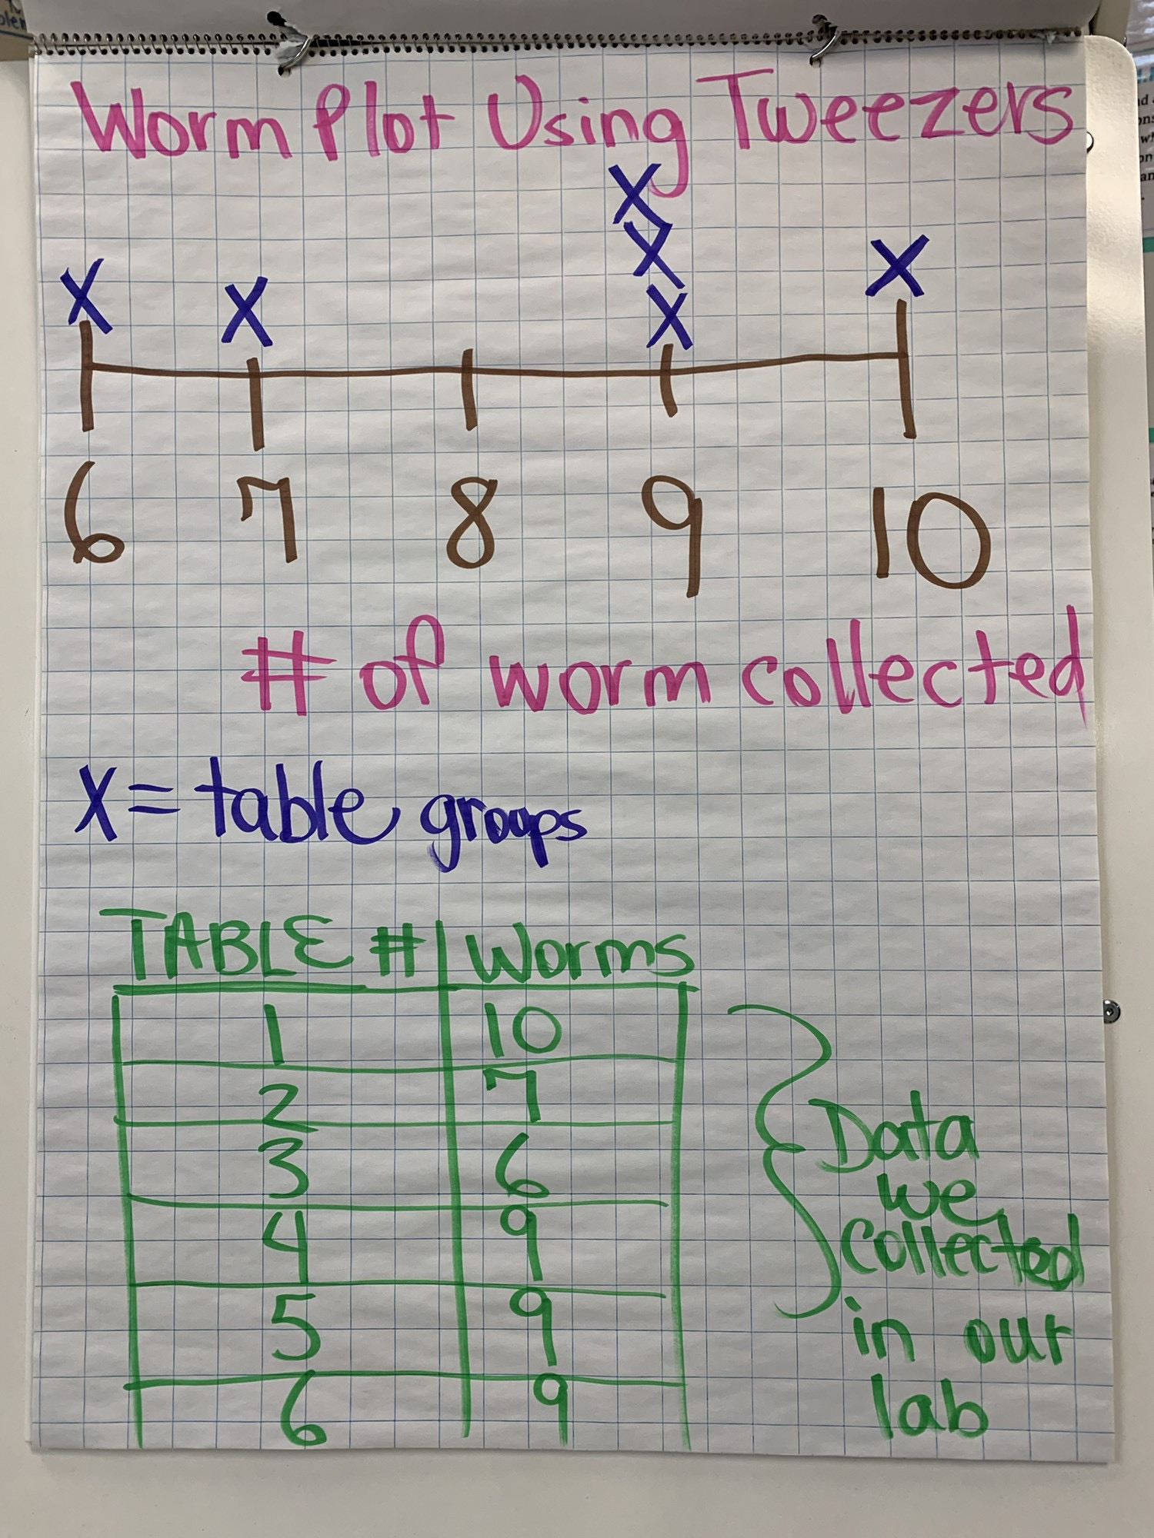
Math Task Examples

Slide 10
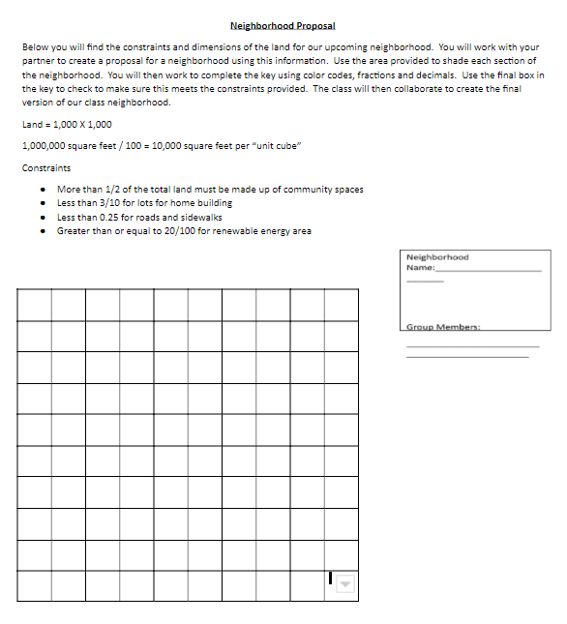
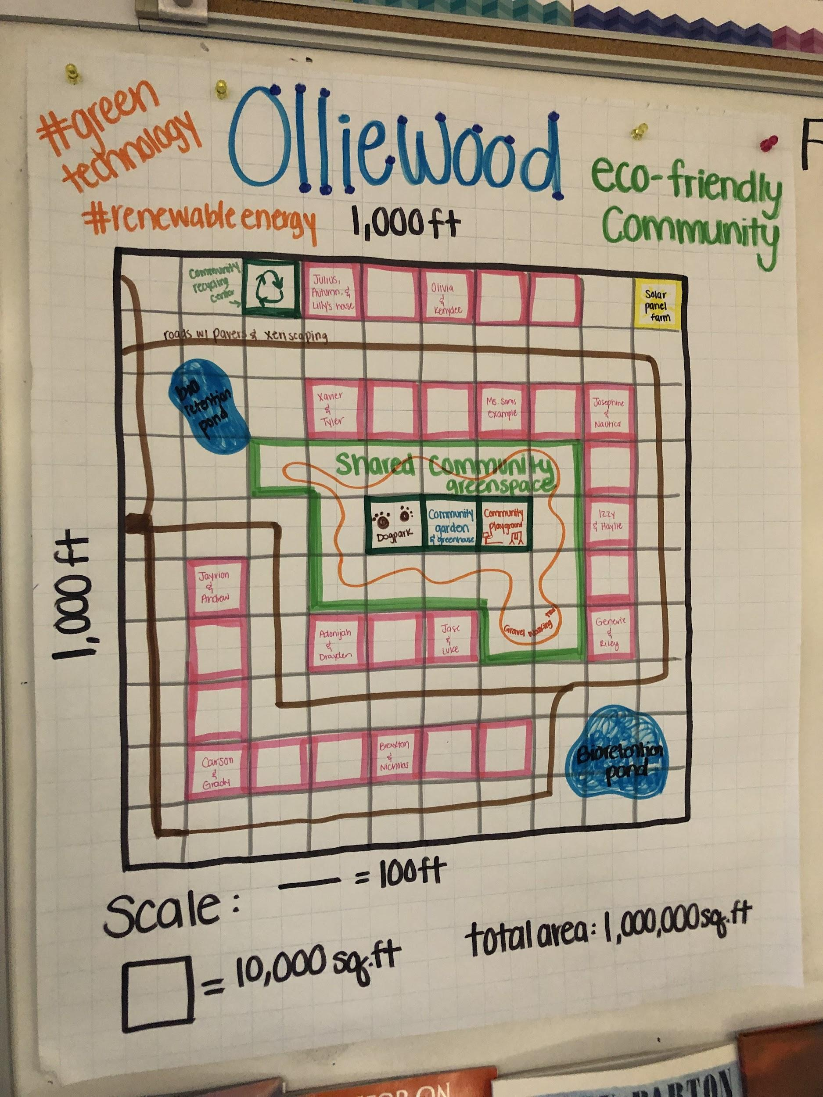
Math Task Examples

Slide 11
Math Task Examples
Ninja Warrior Math Task #1
Part A: The production crew on NBC’s Ninja Warrior is making “Chemical Energy” goody packs for the contestants. What kind of items would need to be included in the goody packs?
Part B: The production crew decided to provide water bottles, protein bars, and sticks of beef jerky to the bags. When purchasing the items, they ended up with 2, 12-packs of water, 3, 6-pack boxes of protein bars, and 4, 9-pack bags of beef jerky. How many of each item did they purchase?
Total bottles of water= ______ Total protein bars= _______ Total sticks of beef jerky= ______
Part C: The production crew wants to create bags with an equal amount of each item for all bags. How many goody bags can they make with the above items, and how many of each item will be in one bag?

Slide 12
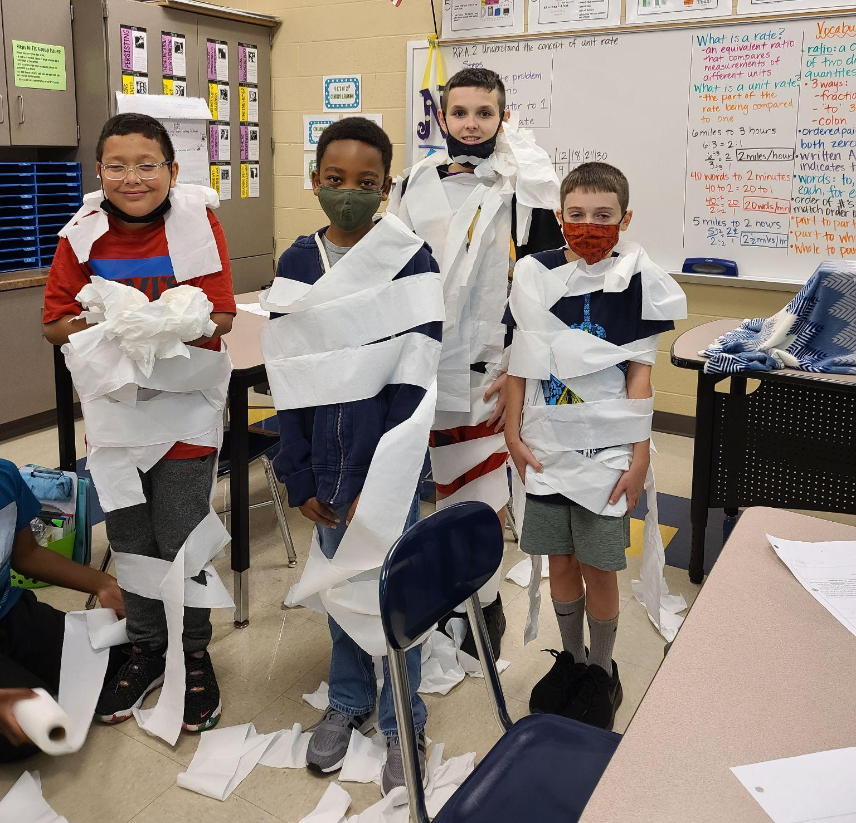
Math Task Examples
Mummy Math Escape Challenge

Slide 13
Step 1
Look through your grade level standard or scope and sequence.
Choose one standard to write a real-world math task.

Slide 14
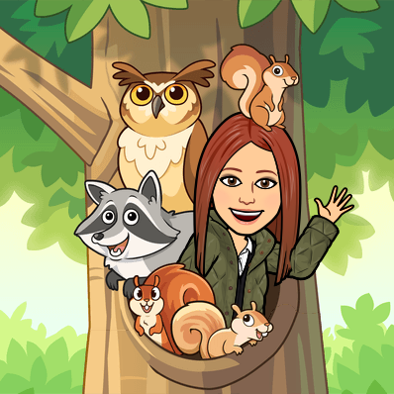
Step 2
Look through science standards or scope and sequence, or consider a real-world current event that you could pair with the math standard.

Slide 15
Step 3
Discover what existing math tasks are already available.
North Carolina
Howard County
Georgia
Task Arcs

Slide 16
Step 4
Create the math task.

Slide 17
Step 5
Get feedback from a peer.

Slide 18
Now It’s Your Turn!
Step 1: Select a math standard
Step 2: Connect with science/ real-world
Step 3: Discover existing tasks
Step 4: Create your task
Step 5: Peer feedback

Slide 19
How We Implement With Our Students
Different variations, but all include:
Independent think time
Partner share
Whole group
Feedback through questioning

Slide 20
Questions
Erin Nunley- erin.nunley@cityschools.net
Cherry Ross- cherry.ross@cityschools.net

