Slide 1
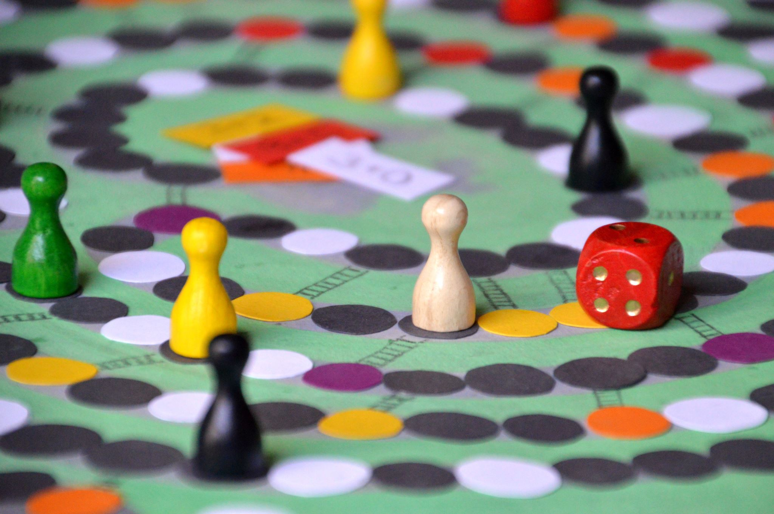
3 Strikes, 3-ish Acts: A Probability Task
Ryan Fox
Belmont University

Slide 2
Let’s play the game! Clip 1: Establish game rules
To play the game here, I’m using one suit playing cards in a paper bag:
The familiar 5, 6, and 7
The ace will be the 1 in this activity
The face cards will be the strikes

Slide 3
You try!
Option 1: Solo game (Modified from The Price is Right). If you draw a number card, place it in its correct correct.
Option 2: Small group activity, mimicking the game.
Member 1: Contestant. Selects card from bag.
Member 2: Host. Knows price of card.
Member 1 guesses position of number, Member 2 identifies right/wrong.
To mimic the experience more accurately, members 3 – n are the audience!
Hoping to land on this question: what are the chances of winning the car?

Slide 4
Let’s see how Brenda did…

Slide 5
What’ s the math with Brenda’s hot streak (so far)?

Slide 6
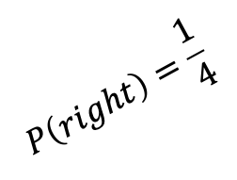
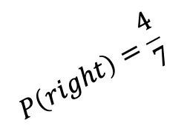
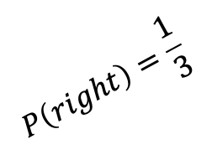
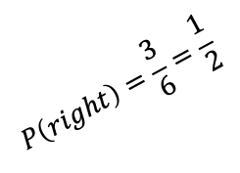
What’ s the math with Brenda’s hot streak (so far)?
$$P\left(right\right)=\frac{1}{3}$$
Number in right spot
Gets a number
$$P\left(right\right)=\frac{3}{6}=\frac{1}{2}$$
Number in wrong spot
$$P\left(right\right)=\frac{1}{4}$$
Number in right spot
$$P\left(right\right)=\frac{4}{7}$$
Gets a number
Gets a strike
Start Game
Number in wrong spot
Gets a strike
$$P\left(\text{first} \text{two} \text{perfect}\right)=\frac{4}{7}×\frac{1}{4}×\frac{1}{2}×\frac{1}{3}=\frac{1}{42}≈2.38\%$$
$$P\left(\text{digit} \text{then} \text{digit}\right)=\frac{4}{7}×\frac{3}{6}=\frac{12}{42}=\frac{2}{7}=28.57\overline{142857}\%$$

Slide 7
Let’s see how Brenda did…

Slide 8
What’ s the math with Brenda’s hot streak?

Slide 9
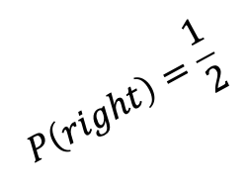
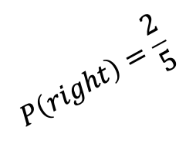
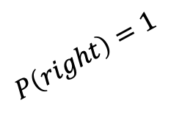
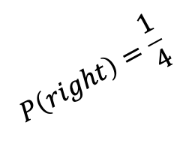
What’ s the math with Brenda’s hot streak?
Wins car
$$P\left(right\right)=1$$
$$P\left(right\right)=\frac{1}{4}$$
Gets a number
$$P\left(right\right)=\frac{1}{2}$$
Number in right spot
$$P\left(right\right)=\frac{2}{5}$$
Gets a number
Gets a strike
First two numbers right
Number in wrong spot
Gets a strike
$$P\left(\text{perfect}\right)=\frac{1}{42}×\frac{2}{5}×\frac{1}{2}×\frac{1}{4}=\frac{1}{840}≈0.12\%$$
$P\left(\text{perfect}\left|\text{first} \text{two} \text{right}\right.\right)=$ $\frac{2}{5}×\frac{1}{2}×\frac{1}{4}=\frac{1/{840}}{1/{42}}=\frac{1}{20}=5\%$

Slide 10
The Sequel
Brenda’s car was $7,651 in 1982. How much would that be in 2024 dollars? How does it compare to the price of a car you by now?
Is playing Three Strikes now harder or easier than it was in 1982? Why or why not?

Slide 11
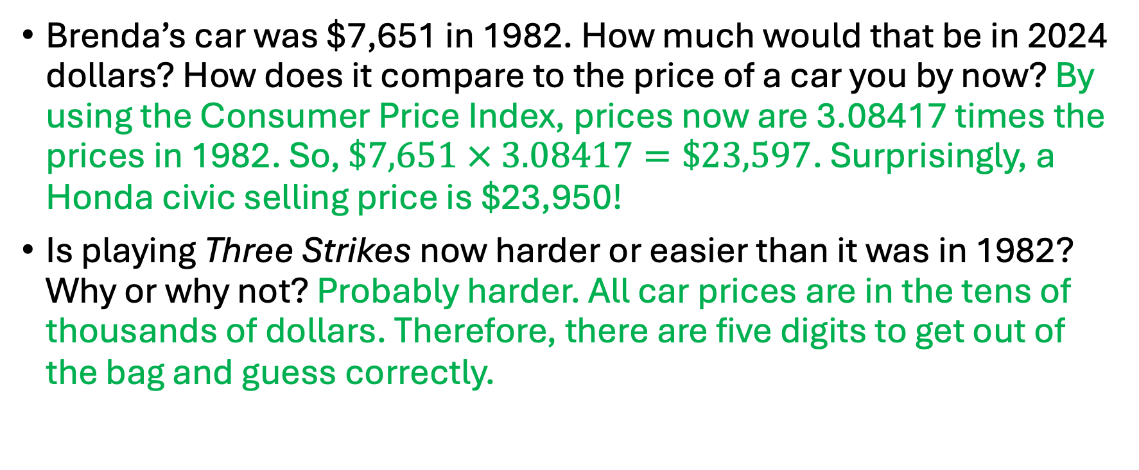
The Sequel Answers
Brenda’s car was $7,651 in 1982. How much would that be in 2024 dollars? How does it compare to the price of a car you by now? By using the Consumer Price Index, prices now are 3.08417 times the prices in 1982. So, $\$7,651 × 3.08417=\$23,597$. Surprisingly, a Honda civic selling price is $23,950!
Is playing Three Strikes now harder or easier than it was in 1982? Why or why not? Probably harder. All car prices are in the tens of thousands of dollars. Therefore, there are five digits to get out of the bag and guess correctly.

Slide 12
Now…on the other hand…
A different 3 Strikes game

Slide 13
What’s the math with Rosemary’s bad luck?

Slide 14
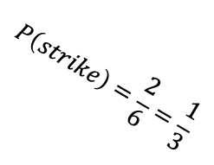
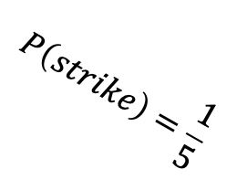
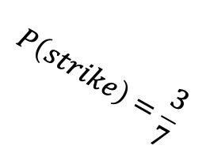
What’s the math with Rosemary’s bad luck?
Gets a number
Start Game
Gets a number
$$P\left(strike\right)=\frac{3}{7}$$
Gets a number
Strike one
$$P\left(strike\right)=\frac{2}{6}=\frac{1}{3}$$
Strike two
$$P\left(strike\right)=\frac{1}{5}$$
Strike three
$$P\left(\text{strikes} \text{out}\right)=\frac{3}{7}×\frac{1}{3}×\frac{1}{5}=\frac{1}{35}≈2.86\%$$

Slide 15
Tennessee (New) Math Content Standards Addressed
8.SP.B.4. Find probabilities of and represent sample spaces for compound events using organized lists, tables, tree diagrams, and simulation. …
b. Represent sample spaces for compound events using methods such as organized lists, tables, and tree diagrams. For an event described in every language (e.g., “rolling double sixes”), identify the outcomes in the sample space which compose the event.
G.S.CP.B.3 (or M3.S.CP.C.5). Find the conditional probability of A given B as the fraction of B’s outcomes that also belong to A and interpret the answer in terms of the given context.*

Slide 16
Thank you so much!
Email: ryan.fox@Belmont.edu
Quasi-professional Insta and Twitter: @drfoxatbu
Link to today’s presentations: http://bit.ly/ryanfoxmtmt2024

